Slide 1
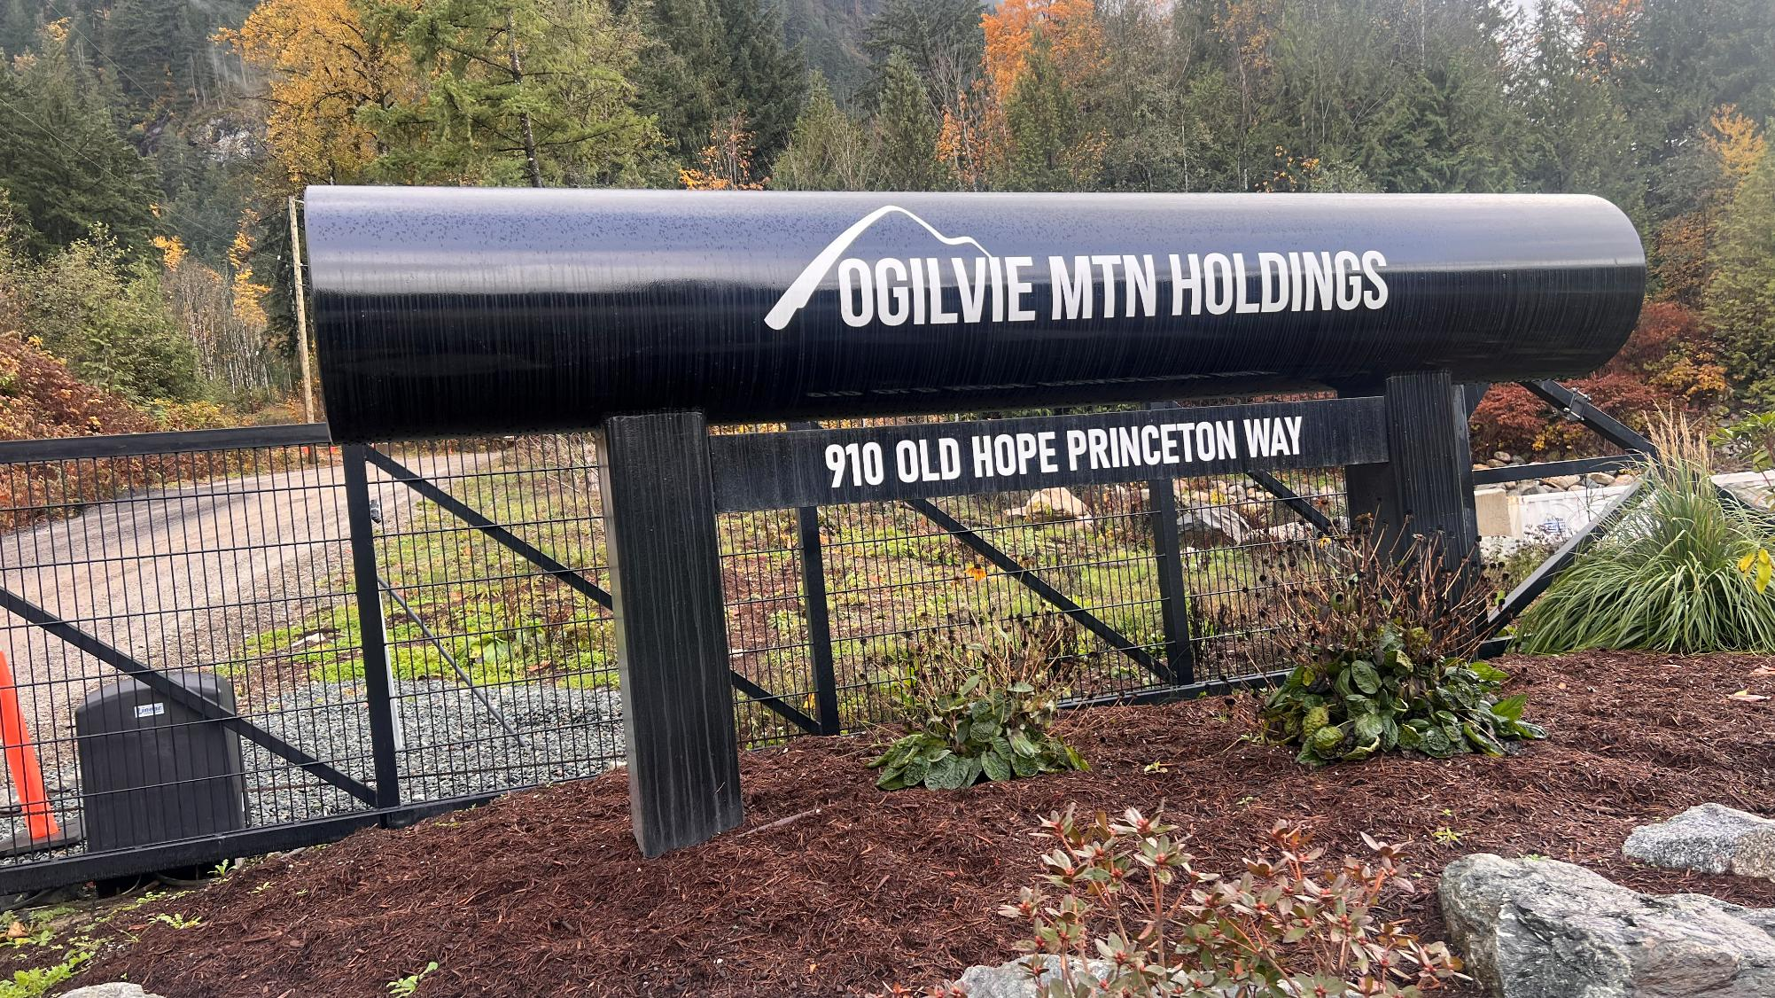
Orientation

Slide 2


Welcome to Ogilvie Mtn Holdings LP, where our commitment to integrity, quality, and safety forms the cornerstone of our operations. Today marks the beginning of your journey with a company that values safety, integrity, and quality above all. We are committed to providing you with the knowledge and tools necessary to ensure a safe and productive work environment.
Ogilvie Mountain Holdings is an established pipeline construction, maintenance, integrity and right-of-way management services company based in Hope, B.C, that has been successfully servicing clients for nearly 25 years. It has long-standing contracts with Enbridge and Trans Mountain and works on traditional lands across British Columbia.
Our guiding principle is:
Integrity is better maintained than recovered
Our Parent Company
Based in Kamloops, B.C., Infracon is an award-winning, progressive, full-service civil construction group of companies, servicing Western Canada and the North. Our group of companies include OMH, Hangingstone Ventures Ltd., SCS, Lower Nicola Site Services and Minex.

Slide 3
EHS Policy

Slide 4


Ogilvie Mtn Holdings is committed to providing a safe and healthy work environment and meeting or exceeding the health and safety standards set by our clients and provincial legislation.
Management is committed to supporting supervisors and workers with a safety program that is designed to prevent injuries and disease in the workplace. Our Health and Safety Polices are an integral part of our economic and social performance and are designed to provide a safe and healthy work environment for our employees, customers, and property in all aspects of our operations.

Slide 5
Conduct and Ethics

Slide 6
The following will not be tolerated on any OMH work location:
Acting in any unlawful way.
Violation of policies, procedures, rules or instructions of the Project.
Physical or verbal abuse, intimidation, or discrimination against any other person.
Fighting with any other worker or a third party
Engaging in inappropriate communication with others that could reflect negatively on the project or OMH.
Working in a way that is unproductive, distracting or dangerous to others.
Engaging in gambling or possessing a weapon of any kind in camps or on work sites.
Theft, dishonesty, or fraudulent activity relating to the project.
Blatant disregard for safety (deliberate or negligent) behavior that affects personnel safety or leads to asset damage.
Disclosure project information, or any media communication without prior authorization.
Breaking camp rules.

Slide 7
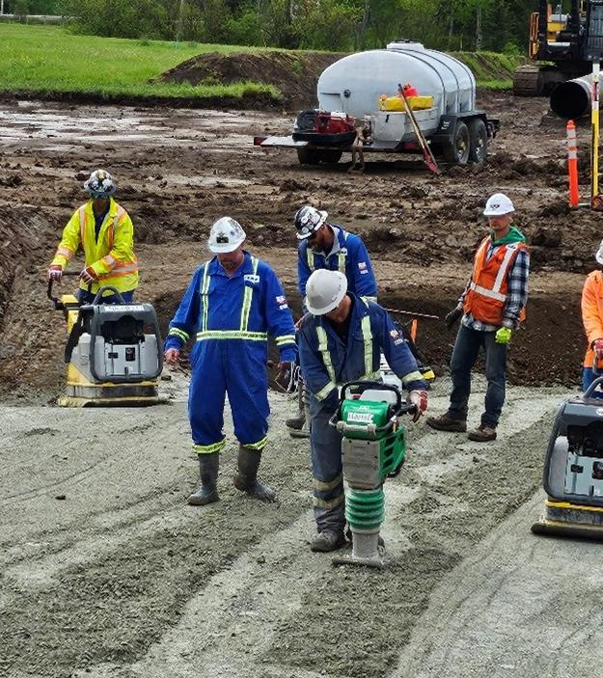
OMH is dedicated to maintaining a safe, respectful, and harassment-free workplace. Any form of violence, bullying, or harassment will not be tolerated. We are committed to ensuring that every worker feels safe and respected.

Slide 8
Bullying and Harassment

Slide 9
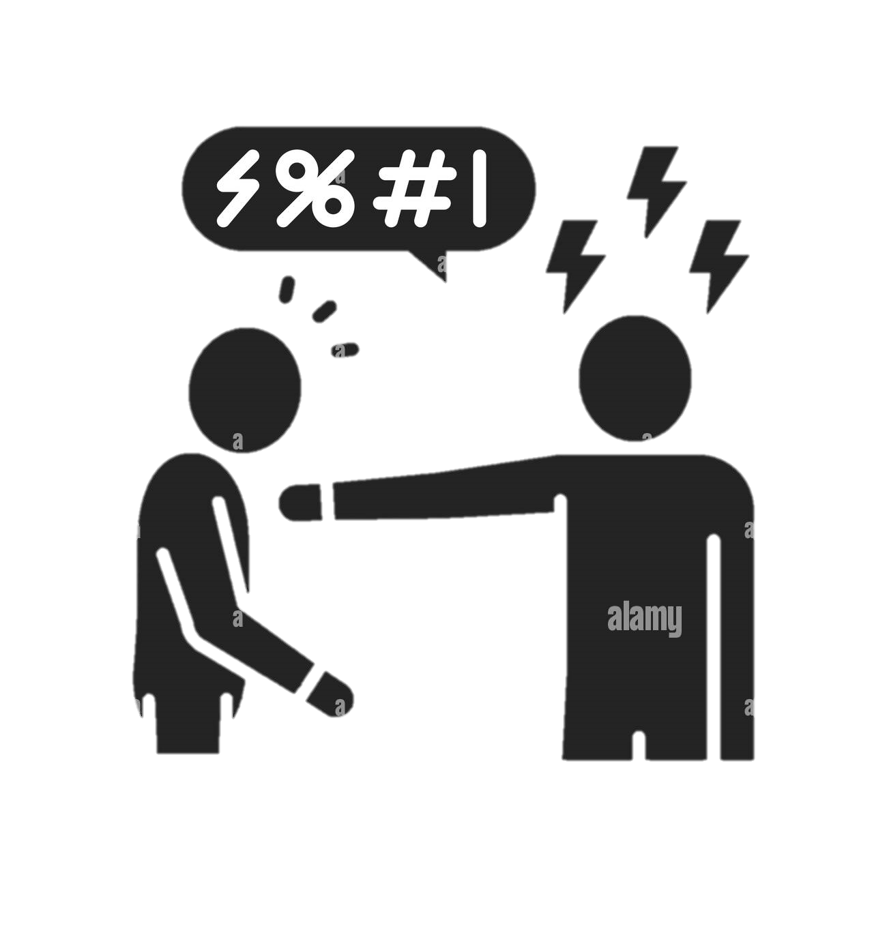

OMH shall provide a safe environment for all personnel, including visitors, customers, and vendors. Acts and/or threats of violence or bullying by employees will not be tolerated.
Employees must report all threats or acts of violence or bullying, both direct and indirect, as soon as possible. If your immediate supervisor cannot be reached, contact any other company supervisory personnel. Be specific when reporting the facts of the incident.

Slide 10
Disciplinary Procedure

Slide 11
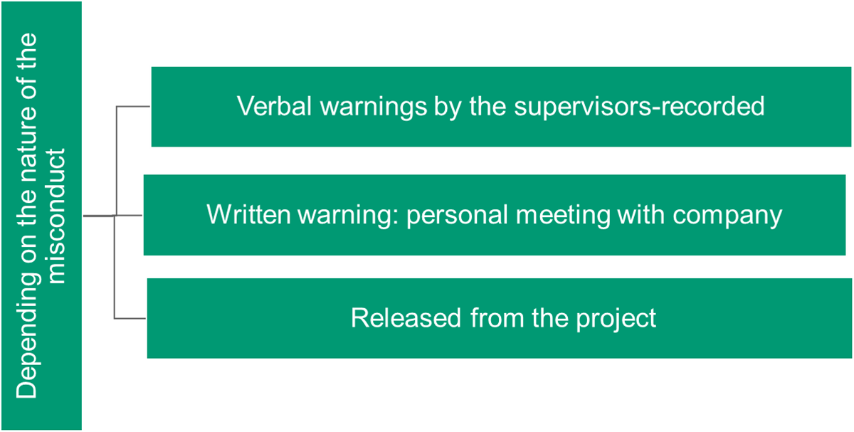
Immediate dismissal can be based on the nature of the offence

Slide 12
Fit for Duty

Slide 13
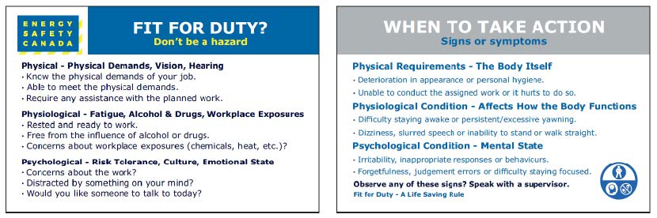

Are expected to be sober, well rested and fit for duty
All workers will be subject to post incident and reasonable cause testing while working on OMH sites
Any workers who refuse to test or fail a test will be terminated from the project immediately
All workers must review OMH’s Drug and Alcohol Policy
"Fit for Duty," encompasses not just physical readiness but also mental well-being. As we navigate through our work in the oil and gas industry it's essential to recognize that mental health plays a significant role in ensuring we are fit for duty.
Being fit for duty traditionally involves being sober, well-rested, and physically capable of performing our tasks safely. However, we must also acknowledge that mental health is equally crucial. Mental wellness impacts our ability to focus, make sound decisions, and react appropriately to changing situations on the job.

Slide 14
Joint Health and Safety Committee

Slide 15

OMH has a Joint Health and Safety Committee made up of both workers and management. The JHSC meets monthly, and each job location is expected to have at least one person participate. Due to the logistics, it's not always practical to have everyone join in person. Folks in the field are encouraged to attend via TEAMS.

Slide 16
New and Young Workers

Slide 17
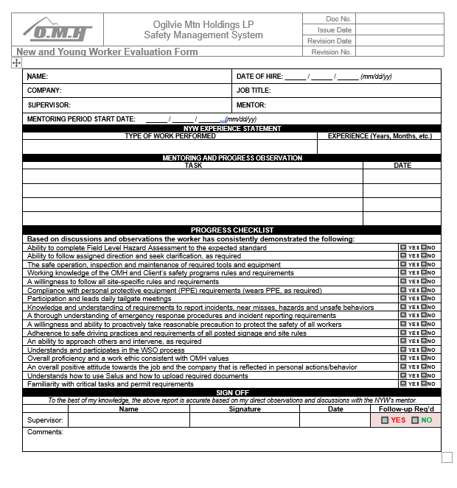

A New/Young Worker (NYW) is defined as an individual who meets any of the following criteria:
New to the workplace.
Returning to a workplace where the hazards have changed during the worker's absence.
Affected by a change in the hazards of a workplace.
Relocated to a new workplace if the hazards differ from those in the worker's previous workplace; and/or
A "young worker," referring to anyone under 25 years of age.
Workers who are new or returning to OMH who have 6 months or more of experience in their assigned job task will not participate in the whole N&Y Worker Program. They will complete the orientation process and be assessed for competency for any tasks that require a competency assessment (mobile equipment operation, sand blasting etc.).
For those who are 25 years of age or younger or have less than 6 months of industry experience will participate in the full NYW Program.
After 1 month of being mentored by an experienced worker, the Supervisor can review and sign off the NYW as having completed the program. The Supervisor will use the OMH New and Young Worker Evaluation form.
At Orientation, the NYW will complete the OMH New and Young Worker Initial Checklist.
OMH extends the definition in its NYW program to encompass:
Summer students; and/or
Any inexperienced or green-hand worker with less than three (3) consecutive months of service with OMH

Slide 18
Workers Rights and Responsibilities

Slide 19
Your rights are:
To know about hazards in the workplace
To participate in health and safety activities in the workplace
To refuse unsafe work without getting punished or fired
Who is responsible for my safety at Work?
Employer is responsible to for ensuring the health and safety of workers and the public. They do this by providing:
Competent supervisors
Training
All of the policies, procedures, practices, tools and equipment to perform the job safely
Workers are responsible to follow and implement the above and look out for their coworkers and the public
Right to refuse unsafe work:
Worker feels work is unsafe
Contacts supervisor
Supervisor and Worker review work to be done:
Supervisor agrees work is stopped until hazards controlled
Supervisor disagrees
Third Party brought in to assess work
If Third party agrees with worker work stopped until hazards are controlled
If Third party agrees with supervisor, the Worker must be given a written statement addressing his/her concerns as to why the job is safe

Slide 20
Workers Responsibilities are:
Be alert to hazards. Report them immediately to your supervisor or employer.
Follow all safe work policies, procedures and practices.
Work Safely.
Wear your PPE at all times on the work site
Co-operate with JOSH members, Safety and Supervisory personnel on inspections, incidents and audits.
Get treatment quickly should an injury happen on the job and tell the health care provider that the injury is work-related.
Follow the treatment advice of health care providers.
Never work under the influence of alcohol, drugs or any other substance, or if you're overly tired.

Slide 21
Interacting with the Public

Slide 22

Interactions with the Public
Questions or concerns from public
Offer to forward their contact information to your Supervisor
Stop your work
In case of unhappy landowners or attempts to stop work
Leave the area
Contact your Supervisor

Slide 23
Incident Reporting

Slide 24
All incidents must be reported to OMH Supervision or Site Safety Representative immediately or when safe to do so. Incidents to be reported are as follows:
PROPERTY DAMAGE
INCIDENT/NEAR MISS
VEHICLE COLLISION/DAMAGE
INJURIES
POTENTIAL HAZARDS
ENVIROMENTAL INCIDENTS
All personnel are responsible, including contractors and subcontractors to follow the above set reporting standards.
No matter how small or insignificant an incident may seem, you must report it to your Supervisor.

Slide 25
Security

Slide 26
Be aware that there is a large amount of expensive equipment on most job sites. There is a high potential for theft if diligent monitoring is not done.
During inspection rounds at the end of shift, ensure that all storage containers and trailers that should be locked, are locked. Keys are to be taken from site each day.
Review the surroundings for any changes or damage upon arrival to the next working shift.
Potential Security Hazards on site:
Youth wandering looking for some excitement
Vandalism
Equipment/fuel theft
Sabotage of facilities or infrastructure
Remote Area
Site Security Measures:
Erect robust perimeter fencing or equivalent barriers to delineate and secure the project's boundaries, effectively deterring and preventing unauthorized access.
Strategically position barriers around open excavations, maintaining appropriate intervals to mitigate the risk of accidental falls and impede unwarranted entry.
Display conspicuous "No Trespassing" signage at all access points and along the perimeter to unambiguously define the construction site's limits.
Keys are to be removed from mobile equipment and vehicles left on site after the work shift ends.
Access Control:
Access is controlled by the site supervisor with the aid of the Medic. The Medic will complete a sign in/out form and inform the site supervisor of any visitors requesting access to the work site. After hours when there is no work activity on site, the worksite will be closed.

Slide 27
Salus

Slide 28

Salus
Salus is the digital platform that OMH uses to store all our safety related documentation. Every paper copy document that is filled out in the field must be uploaded on to Salus. Most forms can be completed on Salus eliminating paper copies.
Start by downloading the Salus App on your phone.
Create a profile and log in.
Once you are assigned to a certain OMH job, you will be added to that job in Salus.
Everyone pull out your phones, download the app and we will do a couple of forms together.

Slide 29
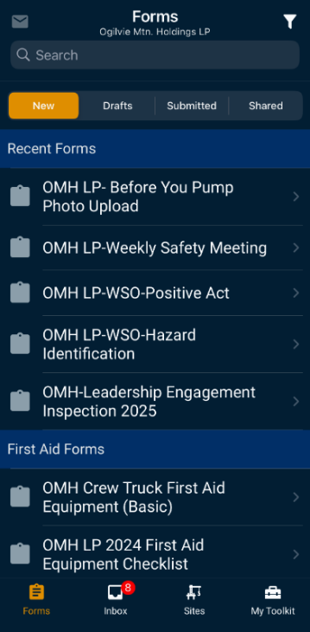
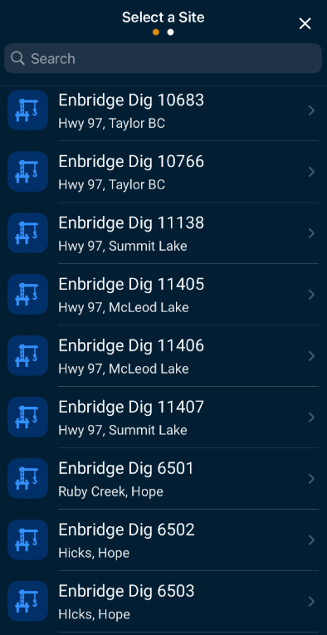
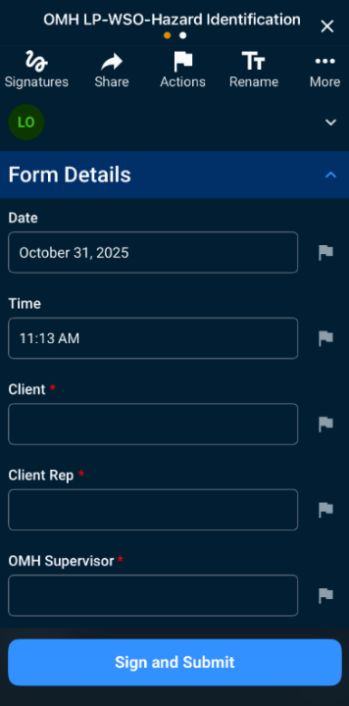
Salus
Choose the form you want to fill out
Choose the job you are working on
Fill in the form and submit

Slide 30
Emergency Response

Slide 31
In the event of an emergency:
1. Stop work, evacuate and secure the area. (Freeze the Scene)
2. Assess to ensure no further danger to yourself or others.
3. Provide first aid and assess requirement for medical assistance.
4. Call Project Medic for additional medical assistance or 9-1-1 if needed.
5. Notify Supervisor of the emergency.
6. Incident Command role is assumed by Supervisor upon arrival.
7. Dispatch a crew member to meet Project Medic / Emergency Services and escort them into the location.
“DO NOT DISTURB THE SCENE OF AN INCIDENT.”
Except to attend to an injured person, to prevent further injury, or to protect property.

Slide 32
Environmental

Slide 33
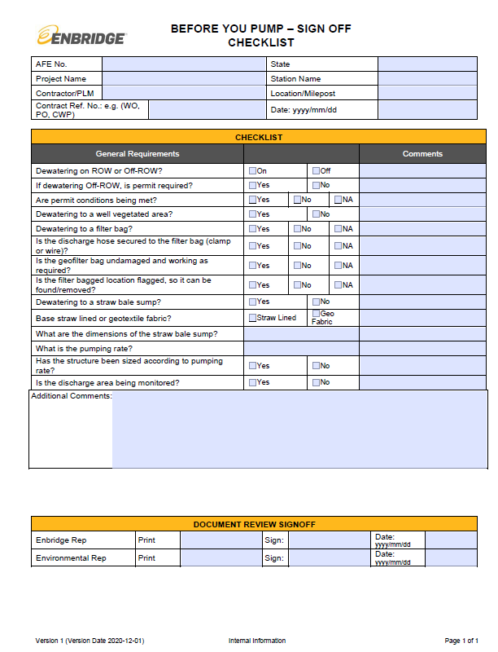
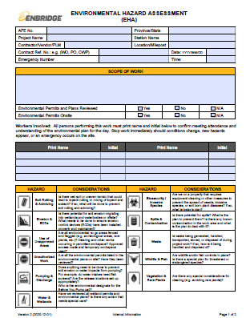
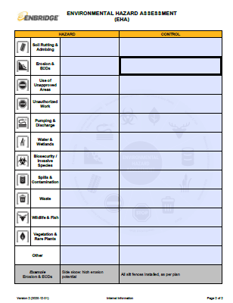
Documents
OMH sites often present specific environmental risks, including working in extreme weather, dealing with wildlife, or ensuring environmental protection during site operations. Follow all environmental protocols and be prepared for changes in weather conditions.
Enbridge required daily environmental paperwork includes:
Before you pump checklist
Environmental Hazard Assessment (EHA)

Slide 34
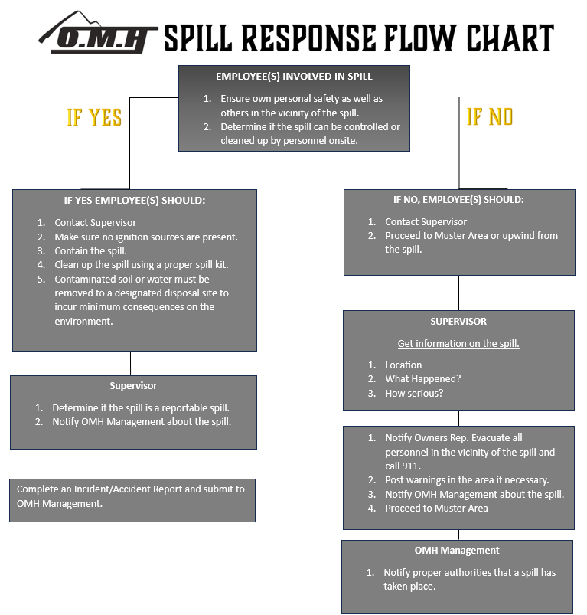
Spill Response
Immediately inform Supervisor and HSE of all spills – document, including photos before and after clean-up.
Ensure equipment is in good working order and inspect daily for leaks or excess grease prior to starting work, even if not in use.
No refueling or servicing of equipment within 30 m of a watercourse/wetland.
Don’t leave refueling unattended or fill tanks to capacity (80% recommended). 2 person fueling is recommended.
Use drip trays during refueling and maintenance.
Adequate spill kits must be present on all machinery.
Secondary containment for all stationary equipment (e.g., gensets, pumps).
Store jerry cans in pickups or designated storage area on-site, and NOT left unattended on the ground.
On-site fuel storage areas must be >100 m from a watercourse / wetland and within secondary containment.

Slide 35

General Environmental Information
Vehicles and Equipment must be equipped with a spill kit.
No re-fueling within 100 meters of any creek / body of water.
Soil handling to coincide with all EPP practices.
All debris and garbage to be disposed of in yard bins.
Feeding or harassment of wildlife is prohibited.
Field personnel are not permitted to have pets on-site or in project vehicles.
Store and dispose of all waste appropriately for the safety of workers and wildlife.
Immediately report any wildlife concerns (e.g., aggressive behavior, conflict animals) or the presence of trapped, injured or dead animals.
Do not approach injured wildlife.
If any wildlife habitat features (e.g., dens, nests) are discovered, notify the Chief Inspector or Environment Lead.
Chance finds and archaeological discoveries
Due to the proximity of some OMH projects to historical lands, there is a chance that archaeological resources could be encountered.
If discovered during construction, suspend work immediately and notify the on-site owner representative.
Do not resume work until approval is received.

Slide 36
Ergonomics

Slide 37
Stage 1
▪ Discomfort may persist for weeks or months but is reversible
▪ Most workers experience aching and weakness during work activities, but improve on days away from work
▪ Interference with work tasks is minimal
Stage 2
▪ Discomfort may persist for months
▪ Symptoms begin more quickly and last longer
▪ Physical signs may be present, sleep may be disturbed
▪ Work tasks may be difficult to perform
Stage 3
▪ Discomfort may persist for months or years
▪ Symptoms are present even at rest
▪ Activities of daily living are disrupted
Risk Identification
1. There are several areas in the workplace that can expose workers to musculoskeletal disorders (MSD) including:
a. Prolonged awkward procedures
b. Repetitive, forceful or prolonged excursions involving the arms, shoulders, neck or back.
c. Frequent and or heavy lifting, carrying, pulling or pushing
d. Vibration
e. Psychosocial factors
Signs and Symptoms
1. The following are signs and symptoms of musculoskeletal disorders:
a. Sharp Pains
b. Dull aches
c. Tingling
d. Numbness
Most workers affected by MSD’s go through the following three stages of increasing discomfort and disability. It is very important that workers and employers recognize the signs and symptoms of injury and make changes long before Stage 3 is reached.
Employer’s Responsibility
1. Employer must ensure that a worker to be assigned to work which requires specific measures to control the risk of MSD is trained in the use of those measures, including:
a. Work procedures
b. Mechanical aids
c. Personal protective equipment
2. Employers must evaluate the effectiveness of the measures taken to eliminate or minimize MSD in the workplace on an annual basis. If measure have been deemed as ineffective, they must promptly make efforts to correct these measures.
3. The employer must, when performing a risk assessment, consult with workers with signs or symptoms of MSD, and a representative sample of the workers who are required to carry out the work being assessed.
4. OMH will ensure that workers whom may be at risk of developing musculoskeletal injury are instructed in the safe performance of the workers work, including the use of appropriate work practices and procedures, equipment and personal protective equipment.

Slide 38
Work Site Observations

Slide 39

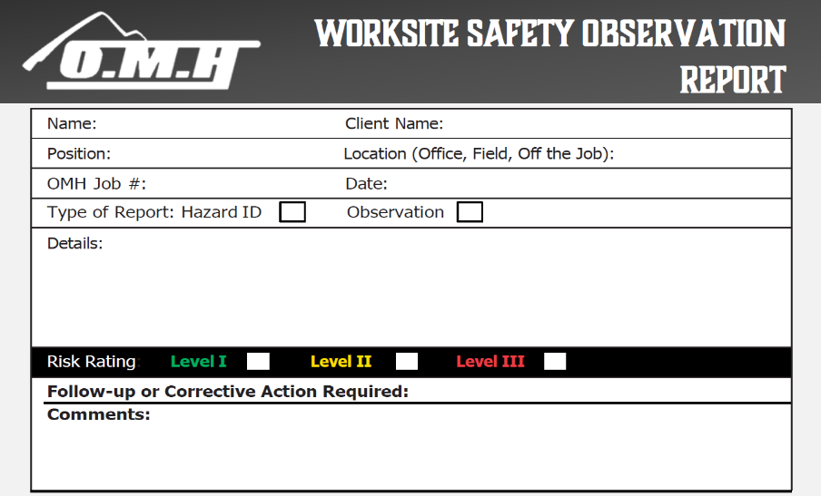
OMH uses a Work Site Observation card to report hazards, near misses, unsafe acts, practices, and/or observations. WSO’s are also used to identify positive behaviors.
An incentive program is established to promote participation and help create a proactive safety culture.
The expectation is that each worker will complete at minimum 1 WSO card per week.
These are to be completed in Salus.

Slide 40
A&D Testing

Slide 41
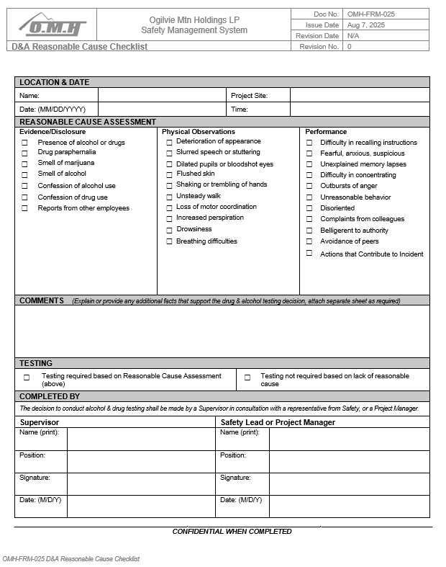
Post Incident A&D Testing Requirements
Minimum testing criteria:
The actions or inactions of an individual, or group of individuals, did or could have contributed to the incident.
The incident occurred at a safety-sensitive work site or while operating a motor vehicle or mobile equipment.
The incident involved one or more of the following serious or potentially serious outcomes:
Fatality to an employee or subcontractor while on duty.
Injury resulting in Lost Time, Medical Aid, Modified or Restricted Work cases.
Property damage exceeding $5,000.
Any avoidable vehicle accidents where the company’s repair is $5,000 or more.
Fire, rupture, or explosion involving company, public, or private property with damage likely to exceed $5,000.
Line strike or damage to buried utilities, pipelines, or cables caused by company personnel or contractors.
Unplanned release of product or chemical that meets a regulatory reportable quantity or enters or threatens a body of water.
Unplanned operational disruption, shutdown, or service interruption with an overall loss exceeding $50,000, or that has a material impact on OMH operations or client operations.
High potential near miss that could have resulted in a fatality or serious injury
Any other incident where there is reasonable cause to believe that an individual may have been under the influence of alcohol or drugs at the time of the event.
Reasonable Cause

Slide 42
Personal Protective Equipment

Slide 43
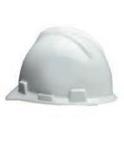

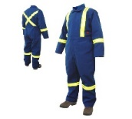
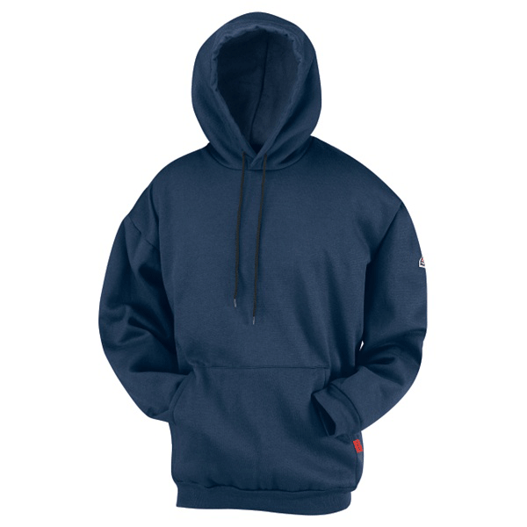

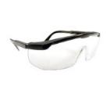
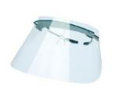
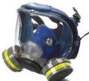
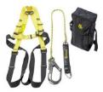
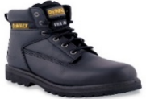
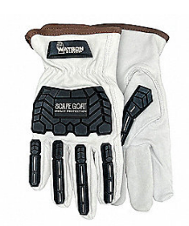
Most OMH jobs are done in “Brownfield” locations. We will provide all required PPE.
CSA approved side impact hard hat. All OMH Supervisors will wear a white hard hat.
FR coveralls or you can provide your own FR outerwear.
Personal gas monitor.
CSA approved safety glasses with side shields. A face shield will be worn for certain activities.
CSA approved footwear, 6-inch minimum height.
Cut 5, impact resistant gloves.
Class 2, Type 2 high visibility outerwear
Any other specialized PPE required for the task.

Slide 44
Permitting

Slide 45

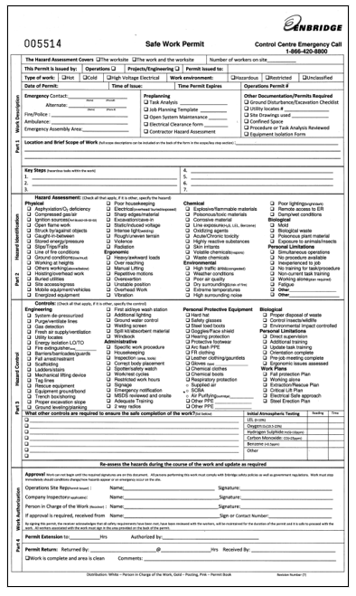
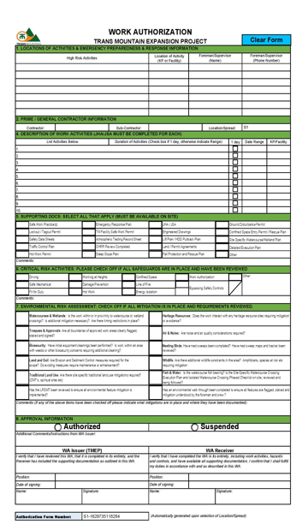
Each client has a different Permitting process. It is the responsibility of each supervisor and worker to review the permit issued by the owner representative prior to starting work. Special tasks such as confined space work will require its own separate permit.

Slide 46
Inspections

Slide 47
Daily documented inspections are required for the following:
All vehicles including cruisers, big rigs, light vehicles etc.
Powered Mobile Equipment – Dozer, Excavator, Skid Steer, Pipe Layer etc.
Fire Suppression Trailers
Trench Boxes
Excavations
Steep Slopes
Fall Protection Equipment
Compressor Stations

Slide 48
Hand Injury Awareness

Slide 49
Hand injuries account for approximately one third of all disabling job-related injuries annually; over 80% of these injuries are caused by pinch points. A pinch point is produced when two objects physically come together, and a possibility exists that a body part (or the entire body) could be caught or injured between the two objects. A pinch point may be created between two moving objects, or between a moving object and a stationary one. Pinch points can impact any area of the body but commonly impact fingers and hands. Slamming your hand or a finger in a door or drawer, for instance, is a common type of pinch point accident involving the hand.
We cannot rely on PPE to be our only defense against hand injuries. Doing a proper hazard assessment, using the proper tool for the job, being competent and confident in the task you are performing a few controls that can help eliminate hand injuries.
OMH requires everyone to wear cut 5/impact resistant gloves while performing any work task.

Slide 50
Knife use poses an increased risk of hand injury to workers who are not aware of the hazards associated with knife use or the ways to prevent injury while using a knife. How can you keep your hands safe when you are using a knife? Let’s discuss.
USE KNIVES ONLY FOR THEIR INTENDED JOB! That is, to cut. Do not use them to pry. Do not use a knife as a screwdriver or an ice pick. If there are other tools that will do the same job, use them. For example, use cutting pliers instead of a knife to cut a tie wrap. Use a wire stripper tool rather than a knife for removing insulation from wires.
COMPLETE A JSA FOR THE TASK. A JSA should be performed on all jobs requiring the handling and use of knives. What is the worst thing that could happen to my hands and body or someone else during your task? Keep your mind on your work at all times.
KEEP YOUR HANDS OUT OF THE LINE OF FIRE. For that matter, keep all parts of your body out of the line of fire. Always cut away from your body and be aware of your “off” hand (the one not holding the knife). When appropriate, use a spring-loaded retractable safety blade that automatically retracts when not in contact with the item you are cutting.
PROTECT YOUR HANDS. Are you wearing gloves and are your gloves cut resistant?
SHARPEN BLADES REGULARLY. A sharp knife cuts with less effort than a dull knife. Having a dull knife increases the chances of your knife slipping and cutting your “off” hand or another part of your body.
LET A FALLING KNIFE FALL. If a knife is falling, you risk injury by putting out your hand to try and catch it, even if you are wearing gloves. Let it fall (be aware of your feet) and then pick it up off the floor once it has stopped moving.
STORE KNIVES SAFELY. Be sure to set knives down away from edges so they do not fall on the floor. Storing knives loose in a drawer with other tools can damage the knife blade. More importantly, it can lead to severe hand injuries if someone were digging through that drawer and unexpectedly came into contact with the blade.

Slide 51
Life Saving Rules

Slide 52


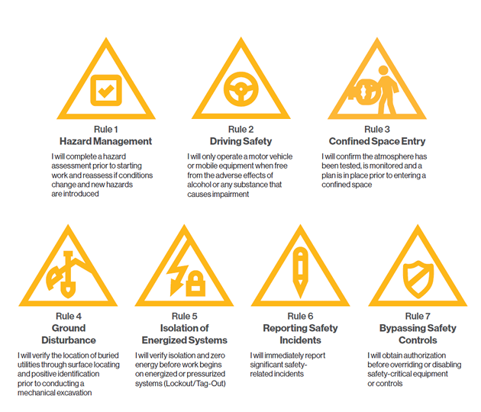
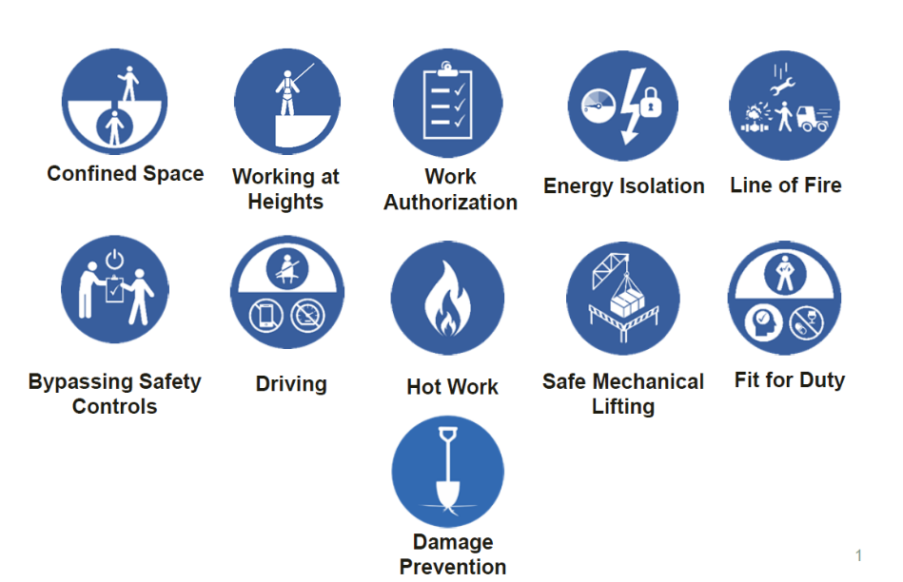

Slide 53
Hazard Assessments

Slide 54
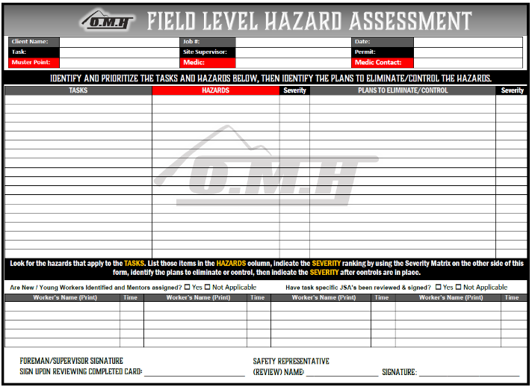
Field Level Hazard Assessments
Purpose:
FLHA is a more dynamic, on-the-spot assessment conducted at the worksite just before starting a job or task.
It focuses on identifying and mitigating hazards that are present in the immediate work environment.
Scope:
Typically, narrower and more immediate.
Performed at the beginning of a shift or when conditions change during a shift.
Documentation:
A simple form that is completed quickly in the field.
May involve a brief discussion or meeting (toolbox talk) to ensure all team members are aware of the hazards and controls.
Updated throughout day or as task changes
Process:
Assess the work environment for any potential hazards.
Identify hazards specific to the task at hand and the current conditions.
Implement control measures to address identified hazards.
Communicate the findings to all team members involved in the task.
Points to consider when filling out your FLHA:
Complete your FLHA in the field, with your crew
Before starting work, assess your work area including housekeeping, weather conditions, lighting area
Do not rush completing the FLHA.
Get input from all crew members.
Identify all hazards - put in the proper controls to eliminate or mitigate the hazard

Slide 55
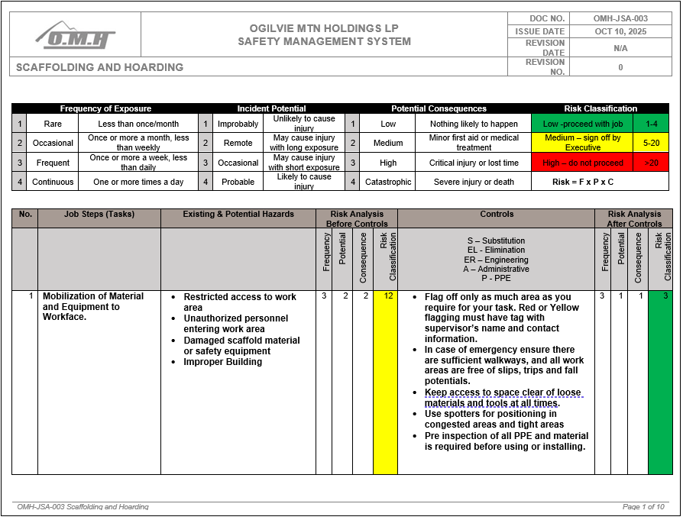
Job Safety Analysis
Purpose:
JSA is a formal, detailed process used to identify potential hazards associated with a specific job or task before the work begins.
It aims to break down a job into individual steps, analyze each step for potential hazards, and determine the safest way to perform each step.
Scope:
Typically, broader and more comprehensive.
Often conducted during the planning phase of a project or before a new job or task is performed for the first time.
Documentation:
Detailed written document outlining each step, the associated hazards, and the control measures to be implemented.

Slide 56
Driving

Slide 57
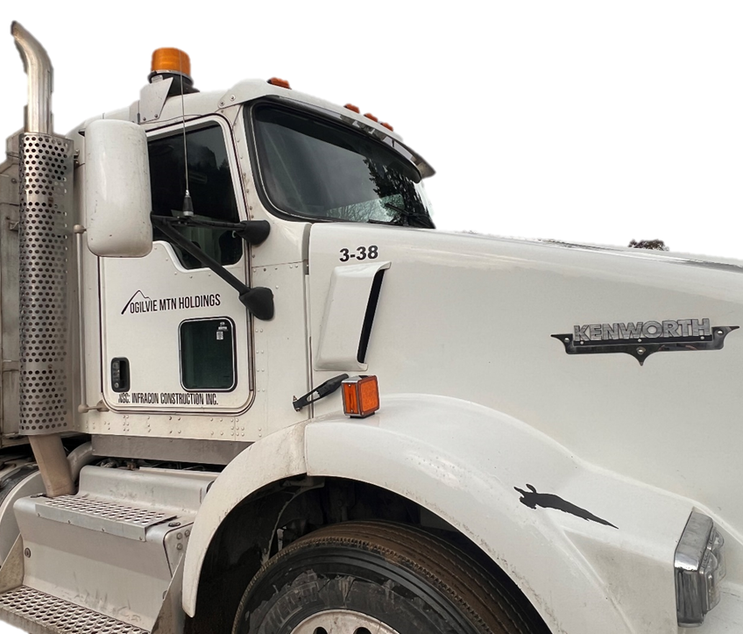
Zero tolerance for speeding
Vehicle operations is in accordance with all applicable regulatory requirements
Only authorized personnel to operate vehicles
Daily Vehicle Inspection must be completed on Salus daily
No riding on equipment or in truck boxes
Drive to road conditions, practice defensive driving
ROW speed limits15 km/hr when passing workers/vehicles otherwise 30km/hr unless otherwise posted
No cell phone usage of any kind while driving
Wear seat belts whenever vehicle is in motion
Ensure housekeeping of unit is kept to standard
Ensure all load securement issues are adhered to
Back in policy in effect
Spotter always required in a congested areas

Slide 58
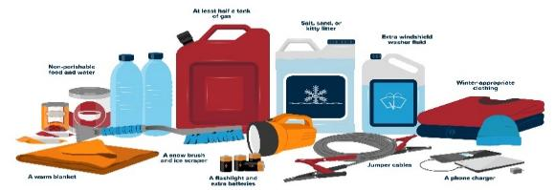
Prior to entering the winter driving season, every driver should prepare their vehicle for the conditions before it’s too late. A complete checkup of the vehicle’s electrical system, brakes, tires, exhaust, heating/cooling system, and windshield wipers are all important components.
In every vehicle, we should have a winter driving kit that also includes emergency items. Some of these items are:
Food – that won't spoil
Water – in plastic bottles
Extra clothing and shoes
First aid kit – with seatbelt cutter
Small shovel, scraper, and snowbrush
Candle in a deep can and matches
Crank flashlight
Whistle – in case you need to attract attention
Roadmaps
Copy of your emergency plan
Sand, salt, or cat litter (non-clumping)
Antifreeze/windshield washer fluid
Tow rope
Jumper cables
Fire extinguisher
Warning light or road flares

Slide 59

The following are some basic, but important, winter driving tips that will keep you safe:
Remove any snow/ice from your vehicle
Allow your vehicle to warm up to reduce frost and moisture buildup
Plan your route
Slow down!
Allow yourself extra time to get to your destination
Maintain a larger following distance when behind other vehicles
Make sure your lights are on and functioning
Do not use cruise control
Steer with smooth and precise movements and don’t slam on your brakes
Ensure the vehicle has winter rated tires in good condition

Slide 60
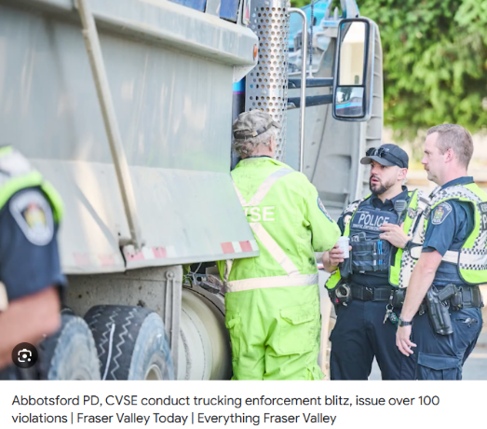

All OMH vehicles that are larger than ½ ton are registered as commercial vehicles and must report to the scales.
All commercial vehicles with a licensed Gross Vehicle Weight (GVW) over 5,500 kg must report to a government weigh scale or inspection station when directed. This includes vehicles that are empty or “bobtailing” (without a trailer) — if the GVW on the registration is over 5,500 kg, you must stop when required by signs or inspectors.
Licensed GVW means the weight limit shown on your vehicle registration document — not the actual weight of the truck when loaded.

Slide 61

You must stop and drive onto the scales:
When there’s a traffic sign indicating “Report to Scales” along the highway.
When a peace officer or authorized CVSE inspector directs you to stop. At the scale, inspectors can weigh the vehicle, measure dimensions, inspect tires and load securement, and check other safety criteria.
If you ignore these instructions, it’s a regulatory offence under the BC Commercial Transport Regulations.
BC uses two kinds of scale systems:
Weigh-in-Motion (WIM) – lets vehicles with transponders be weighed while moving.
If compliant, you get a green “good-to-go” signal and may continue without stopping at the station.
Non-compliant vehicles or ones without a transponder are signalled and must stop.
Automatic Vehicle Identification (AVI) – static scale where all vehicles must stop and be inspected.
Stopping at a scale isn’t only to weigh your truck — inspectors check:
Vehicle weight and axle loads
Load securement and dimensions
Tires, brakes, and other safety systems
Documents like permits and insurance (if required)

Slide 62
Working around Mobile Equipment

Slide 63
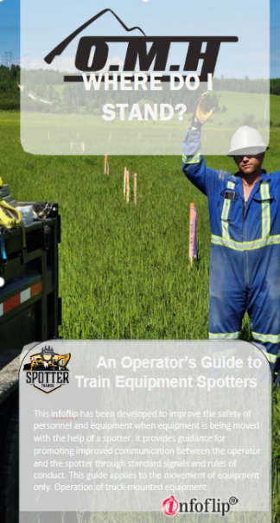

The “Danger Zone” is defined as any location within 6.0m of a piece of heavy equipment.
Prior to operating PMEs, Operators must complete Operator Competency Assessments.
Spotter required for all equipment passing or working under any overhead utilities.
Never assume you are seen. Always make eye contact and get positive confirmation with the Spotter or Operator prior to approaching any machine.
All Spotters must review and sign the Operator’s ‘Where do I Stand” booklet.

Slide 64
H2S Awareness

Slide 65
General
Ignition sources are not permitted to be used in areas identified to have or potentially have H2S present unless specific control measures are in place. (I.e., ventilation during welding)
Short-term exposure to different concentrations of H2S can cause a variety of health effects. The table below provides a summary of the health effects from short-term exposure.
H2S Concentration | Signs & Symptoms
1-10 ppm | Moderately offensive odor, possibly with nausea or headaches with prolonged exposure
15 - 50 ppm | Nose, throat and lung irritation, digestive upset and loss of appetite, sense of smell starts to fatigue, odor cannot be relied upon as warning for exposure
100 – 200 ppm | Sever nose, throat and lung irritation, ability to smell odor completely disappears, immediately dangerous to life and health (IDLH) at 100 ppm
200 – 300 ppm | Marked eye inflammation and respiratory tract irritation after one hour of exposure
500 ppm | Loss of consciousness and possibly death in 30 minutes to one hour
700 - 1000 ppm | Rapid loss of consciousness, cessation of respiration and death

Slide 66

Detecting Hydrogen Sulfide
Workers must use gas monitoring in areas where H2S is expected to be present, which include:
Gas wells, gas refineries where H2S is removed from natural gas and oil
Pipelines used to carry unrefined petroleum that will be crossed and a risk of contact and/or leaks has been identified in the PSSP or through client requirements.
Where H2S could be released during excavation work in swamps or old landfills
Sewage treatment plants, manure tanks, and other places where organic material breaks down without oxygen
Iron smelters, coke ovens and other places where H2S is a by-product
Manholes
Confined spaces
Gas monitors pre-set with specific atmospheric parameters must be used to assess H2S concentrations, and must also be equipped with an audible alarm set to sound when the atmospheric conditions are outside 50% of these Occupational Exposure Limit (OEL) ranges:
Oxygen (O2) – 19.5% to 23.0% by volume
Hydrogen Sulfide (H2S) – 10 ppm
Carbon Monoxide (CO) – 25 ppm
Lower Explosive Limit (LEL) – 10%.
Gas monitors must be function tested, maintained and calibrated in accordance with manufacturer’s specifications.
All work must stop, and the area must be vacated when an H2S alarm sounds
H2S Release
If an area gas monitor is set-up, the location and the site-specific procedures that are to be followed if a warning alarm sounds must be communicated to all workers. If an H2S leak occurs or the alarm sounds, evacuate the area immediately, proceed to your nearest safe muster point and notify your Supervisor/Foreman.
Travel upwind if the release is downwind of you and travel crosswind if the release is upwind of you.
If a crew member goes down, leave the area immediately and call for emergency response.
It is the Supervisors/Foreman’s responsibility to ensure all workers are notified of the location and nature of the emergency and confirm the safe evacuation of all workers as per site specific Emergency Response Plan.
NEVER attempt a rescue in an area that may contain H2S without using the appropriate respiratory protection or without being trained to perform a rescue.

Slide 67
Trench Box Awareness

Slide 68
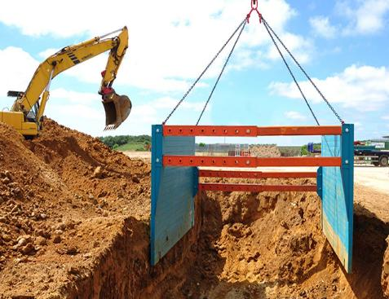
Trench boxes aren’t meant to shore up or support trench walls. They’re only meant to protect workers in case of a cave-in. The space between the box and the trench wall should be backfilled. Otherwise, a cave-in or collapse may cause the trench box to tilt or turn over. It’s also easier to enter the box if soil comes right up next to it. Trench boxes are commonly used in open areas away from utilities, roadways, and foundations. If you’re in the trench, stay inside the box.
In trench boxes, look for
damage and other defects
deformed plates
cracks in welds
bent or distorted welds in sleeves and struts
missing struts
bent struts
holes, bends, or other damage to plates.
During use, check the trench box regularly and often to make sure that it is not shifting or settling more on one side than the other. This can indicate movement of soil or water underneath. If the box is shifting or settling, get out and tell your supervisor about it.
Inspect the ground around trenches for tension cracks. These may develop parallel to the trench at a distance of about one-half to three-quarters of the trench depth. If you find cracks in the ground, alert the crew and double-check your shoring or trench box.
It’s dangerous to overlook damage or defects in protective systems. Even if the job is short-term or almost finished, trenches can still cave in.

Slide 69
Steel trench box installation is generally the first choice to the rapid shoring of trenches that run up to a maximum four meters wide by six meters deep in non-urban environments where ground conditions are reasonable. They are generally used in multiples to continuously support the length of a trench Boxes are available in a wide variety of sizes and weights; they comprise a bass box typically around 2.5 meters high and up to 2 top extension boxes for deeper excavations. Powered Mobile Equipment (PME) is required to handle all boxes, particularly as large pulling forces can be required to extract boxes in cohesive ground.
Two types of strutting systems are available: a fully adjustable strut with a screw thread arrangement or a pin incrementally adjustable strut known as the multi box strut. The units are usually delivered to site broken down in component form. it is essential for the supervisor to be familiar with the equipment by first thoroughly reading the user guide. The first stage in the assembly is to identify all components paying particular attention to the lifting and handling point on the box panels. The two panels most only be lifted at these designated points.
Anyone involved in trench box assembly, installation or extraction must have formal training.
The tabulated data sheet for the trench box must be available for review at the job location.
Shoring and trench boxes must be inspected daily before use.

Slide 70
Transportation of Dangerous Goods

Slide 71
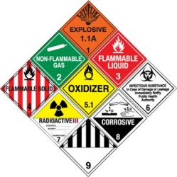
Anyone who handles and transports dangerous goods must have TDG training. Dangerous good are classified as follows:
Class 1 – Explosives
Class 2 – Gases
Class 3 – Flammable Liquids
Class 4 – Flammable Solids
Class 5 – Oxidizing Substances
Class 6 – Toxic/Infectious Substances
Class 7 – Radioactive Materials
Class 8 – Corrosives
Class 9 - Miscellaneous

Slide 72
Working in Wildfire Season

Slide 73
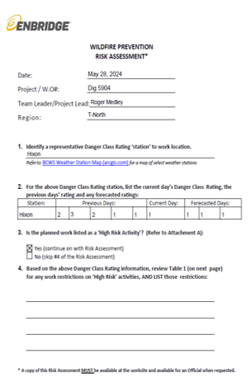
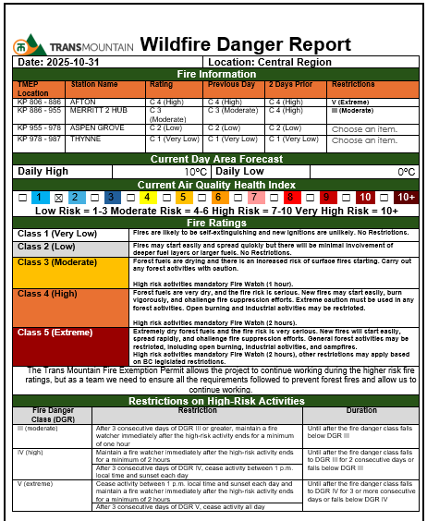
During wildfire season, the use of OMH and Client Wildfire Danger Reports is vital for maintaining safety and compliance in our work activities.
These reports provide the danger ratings for designated zones where we operate, helping us assess and respond to wildfire risks effectively. They also outline specific restrictions that apply when the danger rating (DGR) reaches level III or greater. By staying informed through these reports, we can implement necessary precautions, adhere to safety protocols, and minimize the risk of wildfire incidents.
Your attention to these reports is essential for safeguarding our operations and ensuring the well-being of all personnel and surrounding communities.

Slide 74
Each vehicle and piece of mobile equipment requires the following during wildfire season:
One round nosed shovel
One Pulaski
One hand-tank pump containing 18 liters of water.
High Risk Activities require a Fire Suppression or Water Delivery System
portable pump unit (not affixed to another machine able to maintain 145psi while delivering 135 liters of water per minute from 30m of hose with 9.5mm opening nozzle)
a suction hose
at least 150 m of discharge hose (33mm unlined or 35mm diameter lined hose)
tools and accessories to maintain pump and hose
if a surface water supply is not available, a water source of at least 4500 liters (1000 gallons), can be substituted. It must be at the site, and readily available.
Anyone who is expected to help with fire suppression in the event of a wildfire is required to have S100 training.

Slide 75
Fire hazards and preventative measures
Hazards:
Welding
Smoking/cigarette butts
Flammables liquids
Combustible materials
Poor maintenance on equipment
Coating materials
Preventative Measures:
Supervisors need to correct all fire hazards brought to their attention.
All fire suppression equipment shall be inspected and readily available
Defective equipment to be recharged and replaced
Smoking only in designated areas
Ensure storage and handling of flammable and combustible materials meet applicable regulations

Slide 76

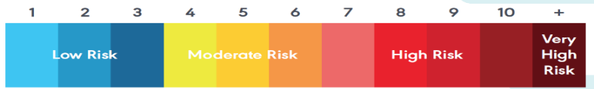
Air quality is a constantly changing hazard, impacting different locations and individuals in varied ways. It's crucial for each team to adapt to local conditions and recognize individual reactions to these conditions.
Here are key safety measures to follow:
Daily Air Quality and Fire Condition Checks: Regularly monitor air quality and fire conditions using reliable sources like Environment Canada and local fire detection maps before heading to the field.
Fit-for-Duty Checks: Conduct regular checks with team members throughout the day. Any difficulty or respiratory issues should be reported immediately to supervisors.
Risk Assessment: When Air Quality Health Index (AQHI) reaches Moderate levels (4-6), perform a risk assessment. Consider suspending outdoor work when AQHI is High to Very High (7 or above), unless critical tasks necessitate it.
Reduce Physical Activity: Adjust physical activity levels to minimize inhaling pollutants.
Immediate Suspension during Forest Fires: If a forest fire occurs nearby and AQHI reaches 7 or higher, suspend all work and move to safe indoor areas.
Regular AQHI Monitoring: OMH LP will continually monitor AQHI to ensure worker safety.
Workers with Respiratory Conditions: Those with diagnosed respiratory conditions must follow physician guidance for outdoor work.

Slide 77
Fire Extinguisher Training

Slide 78
By the end of this training, you will be able to:
Describe of the combustion process and different fire classes.
Describe the function and anatomy of a fire extinguisher.
Describe the process of dealing with a fire
Demonstrate basic fire extinguisher techniques using - The “P.A.S.S.” method
Notes:
BRIEFLY REVIEW OBJECTIVES.

Slide 79
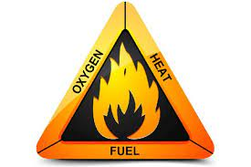

The Fire Triangle/Tetrahedron
The concept of Fire Prevention is based upon keeping these three elements separate.
Notes:
The elements necessary for fire to exist are commonly referred to as the fire triangle.
Three elements must be present for a fire to exist.
There must be:
Oxygen to sustain combustion,
Heat to raise the material to its ignition temperature,
Fuel to support the combustion.
If you remove any of these three elements, the fire will go out.

Slide 80


Fire Classes
Trash Wood Paper
Liquids Grease
Electrical Equipment
Combustible Metals
Cooking Media
K
Notes:
Describe the 5 fire classes pointing out the new (pictogram) and old (letters) symbols.
Most everyone will be using a combination dry chemical extinguisher (ABC). Regardless of the extinguisher get proper training from your employer on its use
NEVER fight a metal fire. The fumes could kill you. Emergency Response Team ONLY fight metal fires.

Slide 81
Fire Extinguisher Anatomy
PRESSURE GAUGE
(not found on CO₂
extinguishers)
DISCHARGE LEVER
DISCHARGE LOCKING PIN
AND SEAL
CARRYING
HANDLE
DISCHARGE HOSE
DATA PLATE
DISCHARGE NOZZLE
BODY
DISCHARGE ORIFICE
Notes:
Point out different components of portable fire extinguisher. Point out that co₂ extinguisher is unique in that it does not have pressure gauge. Emphasize that everyone should know the individual extinguishers in their area; how to find them and how to use them.

Slide 82
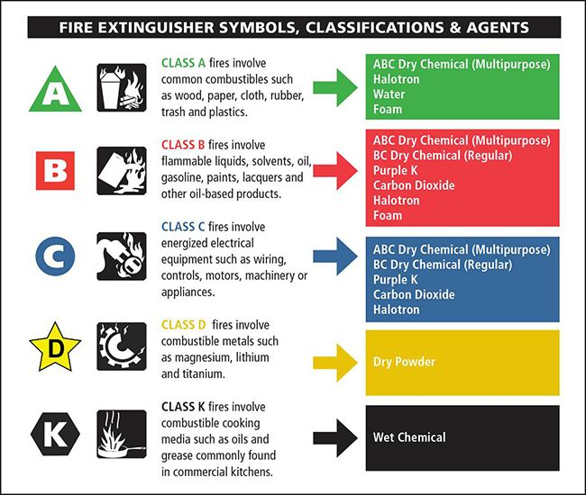
Fire Extinguisher classes
Notes:
Before we dive into how to operate a fire extinguisher, let’s briefly discuss the different types of fire extinguishers. There are four main types of fire extinguishers, each designed to combat different types of fires:
Class A extinguishers are used for fires that involve ordinary combustibles such as wood, paper, or cloth.
Class B extinguishers are used for fires that involve flammable liquids, such as gasoline, oil, or grease.
Class C extinguishers are used for fires that involve electrical equipment, such as appliances or wiring.
Class D extinguishers are used for fires that involve flammable metals, such as magnesium, titanium, or sodium.

Slide 83
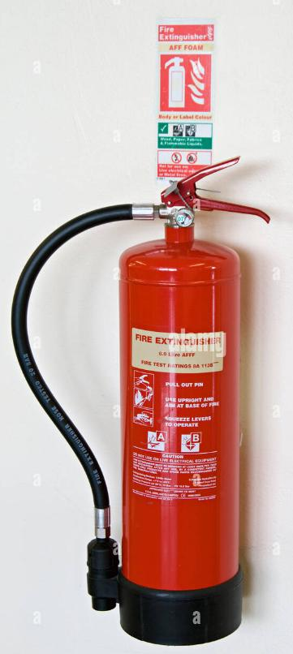
Fire Extinguisher Familiarization
Know the locations of fire extinguishers in your area.
Fire Extinguishers can be heavy. Practice handling them (without discharging them).
Read the operating instructions, identify the type of extinguisher and review any warnings on the labels.
Do Not attempt to discharge the extinguisher. The unit will lose pressure and will have to be replaced..
Notes:
Review slide emphasis on getting familiar with where their extinguishers are and how to inspect and use them. Repeat the warning not to discharge them while familiarizing themselves with the units.

Slide 84
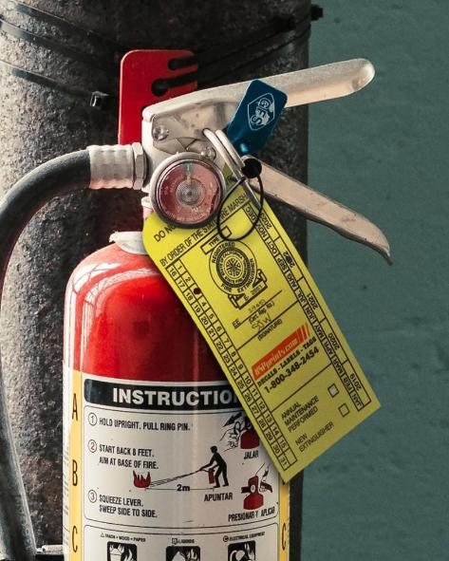
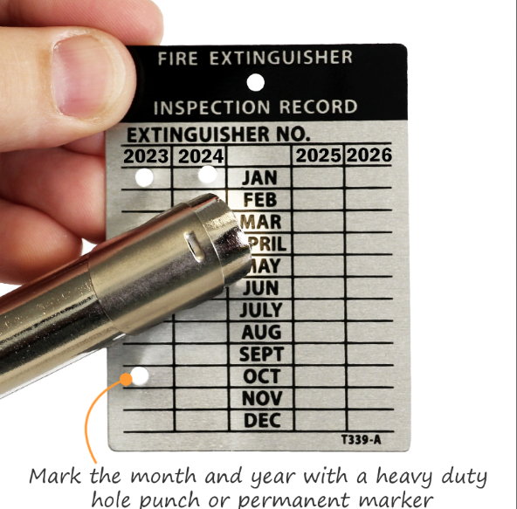
How to Check the Fire Extinguisher
When a fire starts is not the time to check a fire extinguisher. Proper periodic checks will ensure that the extinguisher will work when you need it.
Notes:
Check the tag for yearly tests and monthly inspections.

Slide 85
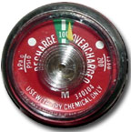
Checking the Extinguisher
Ensure that the pin and the safety seal are in the proper position so that the extinguisher cannot be accidentally discharged.
If applicable, check the gauge to ensure that the pressure inside the extinguisher is in the appropriate area. If it is not in the green area, notify your supervisor so that the extinguisher can be replaced as soon as possible.
Notes:
Review slide

Slide 86

Checking the Extinguisher
Examine the extinguisher for obvious signs of damage or tampering. If either of these conditions are noted, inform your supervisor immediately so that the extinguisher can be replaced.
Extinguishers should be inspected every 30 days.
Everyone is responsible for fire safety in their workplace, so remember to check your extinguishers regularly.
Notes:
Review the slide. Emphasis on monthly inspections and yearly tests. These should be marked on the tag.

Slide 87
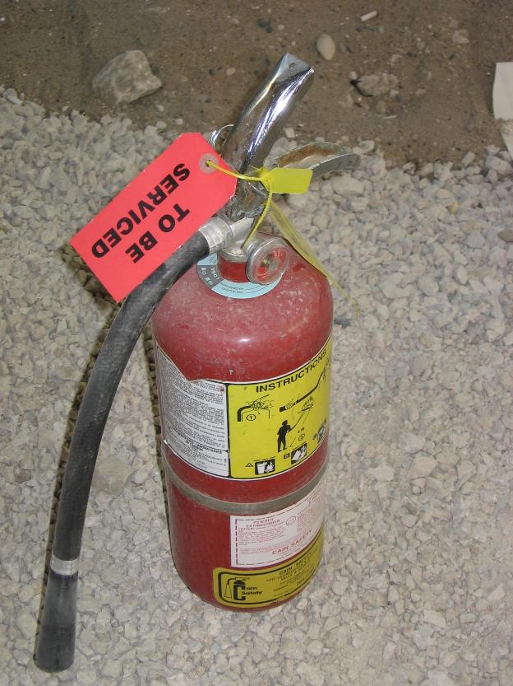
If the extinguisher is not in working condition tag it out of service immediately and replace it.
Notes:
Review slide with emphasis on discovering and removing unserviceable fire extinguishers. If time relate an anecdote.

Slide 88

Dealing with Fire
Get SAFE
Assess
Report to Supervisor/ERT
If safe to do so – fight the fire
If not safe or if there is ANY doubt
GET OUT!
Notes:
Report to Emergency Response team if unable to get in contact with your supervisor. Refer to the contact stickers that were handed out to go on the back of the security cards.

Slide 89
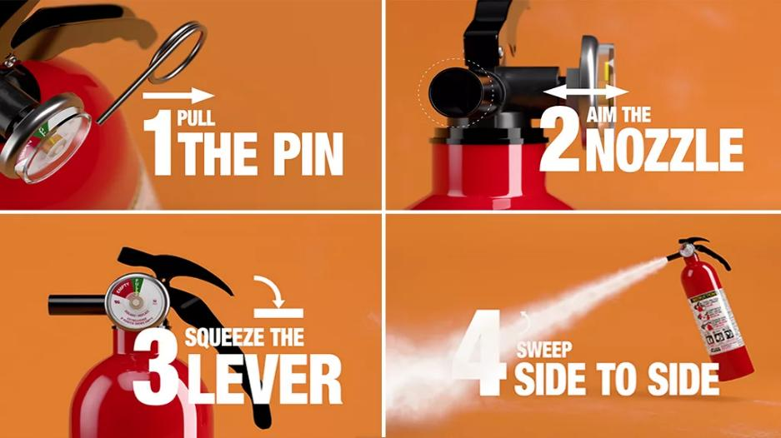
THE P.A.S.S. METHOD
Notes:
How to Operate a Fire Extinguisher
When using a fire extinguisher, remember the acronym PASS, which stands for Pull, Aim, Squeeze, and Sweep:

Slide 90
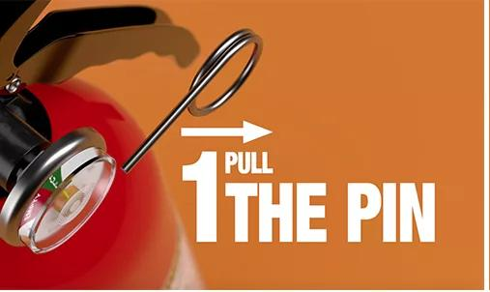
Fighting the Fire
Notes:
Pull the pin: The first step is to pull the pin located on the top of the extinguisher. This will break the tamper seal and allow you to use the extinguisher.
Aim at the base of the fire: The next step is to aim the nozzle at the base of the fire, not at the flames themselves. This is because the base of the fire is where the fuel source is, and extinguishing it will stop the flames.
Squeeze the handle: Once you have aimed the nozzle at the base of the fire, squeeze the handle to discharge the extinguishing agent.
Sweep from side to side: Finally, sweep the extinguishing agent from side to side until the fire is completely out. Make sure you are standing a safe distance away from the fire, and that you do not turn your back on it.
Remember, it is crucial to call the fire department even if you manage to extinguish the fire, as there may still be hot embers that could reignite.

Slide 91
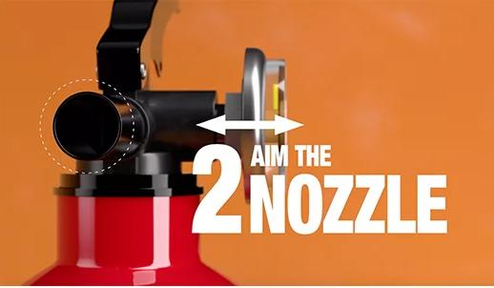
Fighting the Fire
Notes:
Aim at the base of the fire: The next step is to aim the nozzle at the base of the fire, not at the flames themselves. This is because the base of the fire is where the fuel source is, and extinguishing it will stop the flames.

Slide 92

Fighting the Fire
Notes:
Squeeze the handle: Once you have aimed the nozzle at the base of the fire, squeeze the handle to discharge the extinguishing agent.

Slide 93
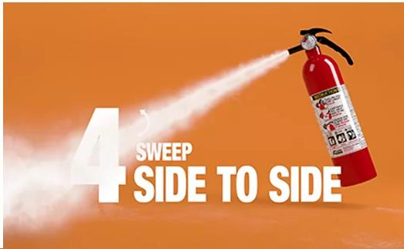
Fighting the Fire
Notes:
Sweep from side to side: Finally, sweep the extinguishing agent from side to side until the fire is completely out. Make sure you are standing a safe distance away from the fire, and that you do not turn your back on it.
Remember, it is crucial to call the fire department even if you manage to extinguish the fire, as there may still be hot embers that could reignite.

Slide 94

Remember…..
When sweeping the nozzle, make sure to cover the entire fire area.
Always aim at the base of the fire.
Notes:
Emphasis on base of fire.

Slide 95
Using the Extinguisher
Use the extinguisher until all of the agent has been used or the fire goes out.
Once you are sure the fire is out…back away from the fire area but remember DO NOT turn your back on the fire.
ALWAYS BE ALERT FOR RE-IGNITION!!!
Notes:
Review slide.

Slide 96

What do I do if the fire is small and contained?
The best time to use a fire extinguisher is in the early stages of the fire.
Once the fire begins to grow it becomes much harder to extinguish.
If in Doubt Get OUT!
Notes:
Ask Learners to repeat the last bullet before showing it. Start with if in doubt …

Slide 97

What do I do if there is a lot of smoke?
Get Out!
It is important to remember that many fires will produce toxic gases that can be fatal even in small amounts.
Notes:
Review slide emphasis that we are not looking for heroes … let it burn if there is any doubt.

Slide 98


Always be alert for fires, they can happen at any time……..
STAYING ALERT FOR POTENTIAL
Heavy Equipment Fire
Notes:
Slides 21 to 27 – Roll through discussing interesting ones that the learners identify. Speed at which you go through slides will be dependant upon time.

Slide 99

Here are some more examples…
MISC Equipment Fire

Slide 100

Wildfires……

Slide 101


Kitchen and cooking fires…….

Slide 102

A grease fire….
Grease fires are one of the most common and most damaging fires that can occur in kitchens.

Slide 103


The office fire…..
Offices are full of combustible materials as well as electrical outlets and equipment.

Slide 104

Always be alert for electrical fires…

Slide 105

Conclusion
Fires can happen anywhere at any time. In a matter of minutes, they can go from a small controllable fires, to large out of control blazes.
Always be alert for potentially dangerous fire hazards in your workplace and report them immediately.
Fire safety is everyone’s responsibility, so remember to do your part.
Stay Alert and Stay Safe
Notes:
Review slide.

Slide 106
Cargo Management Training

Slide 107


Definitions
Hazard- Source or situation with a potential for harm in terms of injury, ill health, damage to property, damage to workplace and environment, or any other definitions as set out by regulations and codes.
Access Point - A primary point of entry for deliveries onto a location
Loading/Unloading Operation - Includes all types of general freight/cargo loads that require lifting/hoisting equipment (i.e. excavator/forklift or crane) to load or unload)
Loading and Unloading Operations
Pedestrian exclusion zones are to be set and identified through the use of deliniators, signage, and cones, or if approved by OMH Safety and Supervision, the use of spotters during operations.
Anyone not directly involved in the operation is not to enter these exclusion zones unless the equipment operator has signaled that it is safe to enter and the equipment operation has ceased all movement
The truck driver is to remain outside the exclusion zone in a designated location (safety zone) during the operation unless otherwise instructed by the operator.
Operators will immediately stop work if the location of the driver cannot be confirmed or any pedestrian or vehicle enters the exclusion zone without permission
Definitions

Slide 108
The most common causes of load securement incidents are related to improper:
Hazard identification
Load securement
Equipment
Use of equipment
loading
Offloading
Other Common causes are related to:
Equipment failure
Line of fire
Human Factors
Poor communication while offloading
Improper load securement can result in:
Loss of life
Loss of load
Vehicle accidents
Damage to the cargo
Damage to vehicles and other property
Load Securement Hazards
Load Securement Hazards

Slide 109

The most common hazards associated with load securement incidents are but not limited to:
Pinch Points
Crush Points
Caught in, under or between loads
Collapsing Material
Stored Energy
Poor Communication
Defective Rigging
Improper Rigging for Task
Heavy Lifts and Suspended Loads

Slide 110
Type 1 – Deliveries
Follow Check-in requirements
Type 2– Deliveries
Follow Check-in requirements
Contractor Representative: Obtain a Safe Work Permit from Client Representative
Type 3 – Deliveries
Follow Check-in requirements
OMH LP Representative:
Obtain a Safe Work Permit from Client Representative
OMH LP Representative must:
Complete a Cargo Management Hazard Assessment (CMHA) specific to the loading/ off-loading operation
Submit completed CMHA to applicable representative, and OMH LP Safety Coordinator for review and filing
Classifications

Slide 111

Type 1 – Delivery / Shipment – routine deliveries – Low Risk
Examples may include: Courier driver delivering/picking-up packages to offices such as purolator/UPS/Fedex/Canadian Linen/Lordco Parts/Drivers delivering food to office-based locations/Drivers delivering Job Trailers/Fire Trailers/Wash Cars

Slide 112


Type 2 – Delivery / Shipment - consumables that do not require lifting or hoisting equipment to unload.
Examples may include:
Fuel for mobile equipment/Washroom Pumping and Cleaning Equipment/ General office consumables/Compressed gas cylinders/ Pipeline Maintenance Chemicals (coating)/Large construction waste bin delivery/General material hauling such as gravel, sand or concrete

Slide 113

Type 3 – Delivery/Shipment - (cargo / freight) –
Loads that are strapped/tethered/ tied down and/or requires lifting or hoisting equipment (i.e. excavator/forklift or crane) to load/off-load.
If unclear, deliveries should be considered Type 3.
Examples may include, but are not limited to:
Tracked and rubber tire equipment/valves/large pumps/ electrical/mechanical equipment/steel pipe/pipe spools/Access matting/Concrete weights/Sand pallets

Slide 116



Delivery drivers are required to check-in at a designated Access Point (i.e Sign in post/site office/radio contact with Foreman or Supervisor) or as otherwise instructed prior to arrival
Upon arrival at the designated Access Point, the applicable Representative will meet the delivery driver
If the delivery is required to enter the work location, the designated representative will meet the delivery driver and:
Confirm the delivery type
Require the driver to sign-in
Verify personal protective equipment
Provide the driver with site specific safety information, as appropriate. This may include:
A site map outlining prescribed driving routes and pre- designated parking / off-loading locations
A listing of key site safety rules (i.e back-in parking, traffic routes, etc.) and/or
Other information that may be relevant to the delivery
Type 1 Delivery Example:
Delivery Check In

Slide 117
Ground Disturbance Training

Slide 118

Training topics
Introduction
Major utilities on OMH Projects
Review of the Damage Prevention Plan (DPP)
What you need to know
Roles and responsibilities
Survey color codes
GD checklist/permit
Vehicle and equipment crossings
Before you go
Crossing / proximity agreements
GD work pack - Task Readiness Verification
GD permit
Pre-construction meeting (tailgate meeting FLHA)

Slide 119

Introduction
This training will ensure all workers clearly understand their role and obligations as defined by the OMH Damage Prevention Plan (DPP)
An examination will follow this training to ensure all workers clearly understand their roles and responsibilities

Slide 120

Before you go – ask yourself…..
What is your scope of work today?
Is your work within 30 m of any known utilities?
Are you "breaking the ground"?
Are you driving over utilities?
Are you crossing any utilities?
Are utilities running parallel / adjacent to your work area / access road?
Are the sweeps partial or full? Do they cover your work scope?
Are the utilities staked around your work area (centerline every 10 m, buffer zone every 20 m)?
Are the utility stakes visible and in good condition?
Do you understand what the utilities stakes are telling you?
Have the utilities been daylighted?
What are your limits of approach?
Do you have the required field issued permits?
Do you need TM, Enbridge, Telus, BC Hydro, inspector(s)?
Are you ready to complete your GD Permit?
If you don’t know, don’t go! Feeling overwhelmed?? Just ask for help!

Slide 121

Major utilities on OMH Projects
OMH projects range from work inside facilities, underground utility work to integrity digs in various locations across the province. With the complex nature of our projects, we work within the parameters of various major utilities at our locations.
Enbridge
Trans Mountain
Telus
BC Hydro
Pembina
CNRL
TC Energy
Deviating from procedure resulting in a utility strike puts us at risk of:
Multiple fatality event
Catastrophic environmental damage
Interrupting energy supply, major transport route
Financial penalties
Daily penalty for individuals: $250 to a maximum of $25,000 per violation
Daily penalty for companies: $1,000 to a maximum of $100,000 per violation
Litigation
Loss of public trust, reputation

Slide 122
Burnaby oil spill
On 24 July 2007 , a 24” pipeline owned by Trans Mountain and operated by Kinder Morgan, was struck and punctured by a contractor's excavator bucket while the contractor was excavating a trench for a new storm sewer line in Burnaby.
Approximately 234 cubic metres of crude oil was released. Crude oil flowed into Burrard Inlet Bay, 11 houses were sprayed with crude oil and 250 residents voluntarily left their homes.

Slide 123

Notes:
While Contractor was working on a sewer line, a backhoe operator ruptured a pipeline carrying crude oil.
The Contractor used as-built drawings from 1957 to locate the pipeline which turned out not being accurate.
Resulted in 224 m3 of crude being spilled onto 44 properties and onto the shoreline through storm water outfall.

Slide 124
Burnaby oil spill
Findings:
The field location of the Pipeline was not accurately indicated on design drawings, which were based on a 1957 drawing
The discrepancy between its location, as shown on the design drawings, and its actual field location was not discovered before the start of construction
Respecting an on-site pre-construction meeting, locating the pipeline, and supervision of construction activities were not adhered to

Slide 125


Utility strike worst case scenario
Evacuation of residential area
Major public health and safety impacts
Loss of public trust
Release of crude oil into the environment and waterways
Catastrophic environmental damage
Long term reclamation efforts
Interrupt energy supply to Western Canada and US
Loss of profits
Cause for litigation
Extensive negative media coverage
Notes:
Top picture: aftermath of Burnaby oil spill
Bottom picture: aftermath of oil spill in wetland area

Slide 126

Enbridge
30” and 36” diameter 1000 psi pipelines supplying natural gas from Northeastern BC to Portland Oregon
Capacity of 3.4 billion cubic feet per day (equates to $14,000,000 per day)
Serves roughly 10,000,000 people

Slide 127

Notes:
Video is showing a controlled burst test.
A section of pipe is buried, filled with natural gas and ignited in a controlled manner.

Slide 128
Burst test
A burst test is the process of slowly increasing the pressure inside the pipeline until failure
Video demonstrates how much energy can be stored inside high-pressure pipelines

Slide 129

Notes:
Video is showing the result of a natural gas pipeline explosion which burned for 12 hours and left 4,000 people without heat in the dead of winter.

Slide 130
Natural gas pipeline fire
On January 25, 2014, a fire occurred on TransCanada’s Canadian Mainline natural gas pipeline system near the community of Otterburne, Manitoba
The incident left more than 4,000 people without natural gas service in the middle of winter
Caused by a manufacturing defect in a valve assembly

Slide 131


Utility strike worst case scenario
Release and ignition of high-pressure natural gas
Multiple fatality event
Large explosion risk
Risk of forest fire in heavily forested area
Major highway shutdown (12,000 vehicles per day)
Property and equipment damage
Disrupt natural gas supply to large areas of the North American West coast
Inter-national news coverage
Loss of public trust
Homes left without heat and hot water
Cause for class-action litigation
Notes:
Top right: natural gas pipeline explosion across large highway
Bottom right: aftermath of natural gas pipeline explosion showing large crater left behind

Slide 132

Notes:
Result of articulating truck bed making contact with overhead transmission lines

Slide 133
Contact with overhead powerline
Bed of articulating truck is seen contacting the overhead powerline
Electricity travels through the truck blowing out the tires

Slide 134

Damage Prevention Incidents
All damage prevention incidents must be reported
GD incident- Call your supervisor
For supervisors:
Contact your client site representative immediately.
Contact OMH Project Manager and OMH Safety Team
Emergency? Call 911
Utility emergency numbers:
BC One-Call: 1-800-474-6886
TMPL: 1-888-876-6711 BC Hydro: 1-888-769-3766
Enbridge: 1-800-663-9931 TELUS: 1-800-474-6886

Slide 135

What is Considered Ground Disturbance?
Ground Disturbance - any activity that disturbs, removes or displaces existing soil or ground cover to any depth is considered a ground disturbance
Ground disturbance includes:
Driving vehicles / equipment over buried utilities
Excavating, ditching
Roadway maintenance including blading gravel surfaces
Removing false fill or stockpiled material
Use of hand tools (shovels, picks, rakes, Pulaski tools, etc.)
Environmental measures such as installation of silt fence
Driving fence posts, bars, rods, pins, anchors or pilings
Posts or foundations for signage
Erecting snow fence with t-posts
Cutting, grinding and milling of asphalt or concrete
Drilling or auguring
Blasting
Backfilling
Vibration

Slide 136




What is Considered Ground Disturbance?

Slide 137

Definition of a Utility
Utility - any buried or exposed service or structure, including but not limited to:
Oil or gas distribution and transmission lines
Fiber-optic lines
Electrical
Sewer lines
Telephone lines
Water lines
Anchor blocks
Buried concrete protection pads
Piles
Overhead or underground powerlines
Cathodic protection systems

Slide 138
Objectives of the GD program
The primary objective of the GD program is to prevent damage to Client assets and all other foreign utilities during construction of the project
It defines the standards, procedures, work practices and guidelines for safe and efficient project GD activities
It defines the roles and responsibilities of Site Supervisor, Ground Disturbance Supervisor and Workers regarding ground disturbance
It demonstrates that the damage prevention strategy is consistent with, and supports, the OMH Vision of SAFE CONSTRUCTION PROGRESS

Slide 139
What you need to know: Roles and responsibilities
OMH Site Supervisor
Complete One-Call notification prior to start of activities
Ensure that a Verification Locate has been completed prior to start of activities
Collect and compile documents for ground disturbance package
Provide training records to Client Representative, when applicable
Receive Ground Disturbance Permit (received by Qualified Ground Disturbance Supervisor)
Oversee Subcontractors’ Ground Disturbance Permit
Conduct the ground disturbance activity
Assign the Qualified Ground Disturbance Supervisor
Make all efforts to contact the facility owner when an unknown facility is identified

Slide 140

What you need to know: Roles and responsibilities
OMH Site Supervisor
Task Readiness Verification that the Ground Disturbance
Package is complete and has been reviewed prior
to starting work activity.
This must be signed off by the Supervisor
and OMH Management.

Slide 141
What you need to know: Roles and responsibilities
Ground Disturbance Supervisor
Receive SWP on behalf of the Ground Disturber (Supplier) and lead the Job Hazard Analysis (JHA)/Job Safety Analysis (JSA) portion of this process
Receive Ground Disturbance Permit on behalf of the Ground Disturber (Supplier)
Has Stop Work Authority
Be present for the duration of all ground disturbance activities
Obtain and maintain regulatory approved training
Provide required information to the appropriate parties
Oversee work in adherence to the SWP, Ground Disturbance Permit and Standard, including work of subcontractors
Manage ground disturbance package
Facilitate pre-ground disturbance meeting
Ensure discrepancies have been resolved

Slide 142

What you need to know: Survey Colour Codes

Slide 143

What you need to know: Stake Colour Codes
Orange = communication cable (TELUS fibre optic)
Pink and black stakes
(5 metre buffer zone)

Slide 144

What you need to know: LIMITS OF APPROACH - TRANSMOUNTAIN
Trans Mountain Pipeline
30 metre Prescribed Area
GD permit signed by TM representative before proceeding
Prescribed Area Permit (PAP) required
PAPs are in GD work packs
Only perform GD activities covered by PAP
TM representative may be present
10 metre spacing between centerline stakes (yellow)
20 metre spacing between SHZ stakes (pink and black)
5 metre (before daylighting)
GD permit signed by TM representative before proceeding
Prescribed Area Permit (PAP) required
Hand/vacuum excavate only
Can mechanically excavate if daylighted and approved by TM (refer to DPP 5.1.7)
2 metre Safety Hot Zone (after daylighting)
Damage Prevention Inspector (DPI) must be present
GD permit signed by DPI before proceeding
Prescribed Area Permit (PAP) and approved variance required
Only perform GD activities described by variance
Must be marked every 20m with pink and black stakes
0.6 metre
DPI must be present
GD permit signed by DPI before proceeding
Prescribed Area Permit (PAP) and approved variance required
Hand/vacuum excavate only. No mechanical excavation
Hand tools that could damage buried utilities are prohibited
Only perform GD activities described by variance

Slide 145

What you need to know: LIMITS OF APPROACH - TELUS
Telus
30 metre
GD permit signed by TM representative before proceeding
Telus inspector must be notified of work activities
Telus inspector may request to be on site
Only perform GD activities at inspector's discretion
10 metre spacing between centerline stakes (orange)
20 metre spacing between buffer stakes (pink and black)
5 metre (before daylighting)
GD permit signed by TM representative before proceeding
Telus inspector must be present or have valid field issued permit
Hand/vacuum excavate only
Can mechanically excavate if daylighted and at inspector's discretion
Must be marked every 20 metres with pink and black stakes
3 metre buffer (after daylighting)
GD permit signed by TM representative when working within 2 - 3 metres
GD permit signed by DPI when working within 1.5 - 2 metres
Telus inspector must be present or have valid field issued permit
Can mechanically excavate at inspector's discretion
Must be marked every 20 metres with pink and black stakes
1.5 metre
GD permit signed by DPI before proceeding
Telus inspector must be present at all times
Hand/vacuum excavate only. No mechanical excavation
Hand tools that could damage buried utilities are prohibited

Slide 146

What you need to know: LIMITS OF APPROACH - ENBRIDGE
Enbridge
30 metre Prescribed Area
GD permit signed by Enb representative before proceeding
Need valid Pipeline Locate Report (PLR)
PLRs are issued in the field by Enbridge, kept in GD work packs
Only perform GD activities covered by PLR
10 metre spacing between centerline stakes (yellow)
20 metre spacing between buffer stakes (pink and black)
10 metre buffer (before daylighting)
GD permit signed by Enb representative before proceeding
Enbridge inspector must be present
Need valid PLR
Hand/vacuum excavate only
Can mechanically excavate if daylighted and at inspector's discretion
Must be marked every 20 metres with pink and black stakes
5 metre (after daylighting)
GD permit signed by Enb representative when working within 2 - 5 metres
GD permit signed by Enb Inspector when working within1 - 2 metres
Enbridge inspector must be present
Need valid PLR
Can mechanically excavate at inspector's discretion
1 metre
GD permit signed by Enb Inspector before proceeding
Enbridge inspector must be present
Need valid PLR
Hand/vacuum excavate only. No mechanical excavation
Hand tools that could damage buried utilities are prohibited

Slide 147

What you need to know: LIMITs OF APPROACH – FORTIS BC
FortisBC
TP: transmission pressure (greater than 700 kPa)
IP: intermediate pressure (greater than 700 kPa)
DP: distribution pressure (700 kPa or less)
30 metre
GD permit signed by client representative before proceeding
Permit required when working within FortisBC right of way
Written permission required when working within TP pipeline
10 metre
GD permit signed by client representative before proceeding
Permit required when working on TP pipeline
On-site pipeline locate when working on IP pipeline
5 metre (before daylighting)
GD permit signed by client representative before proceeding
Hand/vacuum excavate only
Can mechanically excavate if daylighted and at inspector's discretion
2 metre (after daylighting)
GD permit signed by client before proceeding
Permit required when working on IP pipeline
FortisBC inspector must be present when working on DP gas main larger than 10”
1 metre
GD permit signed by client before proceeding
Hand/vacuum excavate only. No mechanical excavation

Slide 148

What you need to know: working around Shaw
Shaw
5 metre (before daylighting)
GD permit signed by client when within 2 meters and before proceeding
Shaw inspector must be present
Must have locate construction details before proceeding
Hand/vacuum excavate only
Can mechanically excavate if daylighted and at inspector's discretion
1.5 metre (after daylighting)
GD permit signed by client before proceeding
Shaw inspector must be present
Must have locate construction details before proceeding
Hand/vacuum excavate only. No mechanical excavation
Hand tools that could damage buried utilities are prohibited

Slide 149

What you need to know: LIMITs OF APPROACH – BC HYDRO
BC HYDRO
BC Hydro issues a 30M33 Form – Assurance in Writing
Table 19-1A: Minimum approach distance for working close to exposed electrical equipment and conductors
Phase to phase | Minimum Distance
 | Metres | Feet
over 750 V to 75 kV | 3 | 10
over 75 kV to 250 kV | 4.5 | 15
over 250 kV to 550 kV | 6 | 20
When working in proximity of electrical equipment and conductors
GD permit signed by TM representative before proceeding
30M33 form required
30M33s are in GD work packs
Follow minimum approach distance on Table 19-1A
Physical barriers (goal posts) installed when crossing under powerlines
TM representative may be present
When working in proximity of buried electrical equipment and conductors
Refer to conditions specified in agreements

Slide 150


What you need to know: LIMITs OF APPROACH – District of Hope
Written notice to commence work 3 working days.
Do not commence or carry out any work within the crossing area without a representative present at all times

Slide 151

What you need to know: Vehicle and equipment crossings
General
During construction, vehicles will be restricted to designated crossing locations
The depth of cover and soil type/condition has to be verified
The contractor will maintain all vehicle and equipment crossings, which the DPI will periodically inspect
Transmountain
Must daylight pipeline on each side of the crossing (unless installing airbridge)
Work with the DPI to determine what will be required to build a crossing
Enbridge
Must have valid agreement for the crossing location
Must daylight pipeline on each side of the crossing
No stopping or parking within the easement
Work with the Enbridge inspector to determine what will be required to build a crossing
A field permit (PLR) will be issued once the crossing has been built and been deemed suitable by the inspector
Telus
Must have valid agreement for the crossing location
Work with the TELUS inspector to determine what will be required to build a crossing
A field permit will be issued once the crossing has been built and been deemed suitable by the inspector

Slide 152

What you need to know: Vehicle and equipment crossings
Confirm you have a valid permit from utility owner
Ensure the vehicle / equipment you are operating is on the approved vehicle list
Do not stop or park on the crossing
Ensure only one vehicle crosses at a time
Cross slowly and cautiously
Cross as close to 90 degrees as possible
Do not drive directly in parallel to the buried utility

Slide 153


BEFORE YOU GO: Documentation
Prior to conducting GD activities, you must ensure you have the following documentation with you:
GD work pack
Task Readiness Verification Completed
OMH GD checklist/permit

Slide 154
Before you go: Crossing / proximity agreements
Agreements hold important information such as:
Depth of cover required to cross a buried utility
Approved vehicle crossing list
Limits of approach
Method of crossing (air bridge, rig mats, etc.)
All crossing and proximity agreements must be on site prior to starting work including:
TM, Enbridge, Telus, BC Hydro, Fortis BC and the Municipality of Hope
The agreements are put in waterproof tubes and hung at access roads and at work fronts
If you are entering a new work area or think there is an agreement missing, reach out to Ground Disturbance ASAP and before proceeding with the work
No agreement = You are trespassing

Slide 155


Before you go: GD work pack
Ground disturbance work packs are a compilation of documents that are required before ground disturbance activities can start:
Utility agreement table and schedule drawings: Table off all agreements and corresponding schedule drawings. Note this is for information only. The full agreements are available in the tubes and must be reviewed by the foreman in the field
BC One-Call ticket and responses: System used to notify utility owners that a ground disturbance may occur within proximity of their utility. Utility owners respond with maps, and sketches
Variances: A variance of the DPP in case it cannot be followed.
Field issued permits: Permits that were issued to us by the utility owner inspector allowing us to do work or otherwise in a certain area
Two 4-way sweeps (locate reports): Two independent subcontractors walk an area with locating equipment to locate and stake buried utilities

Slide 156

Before you go: BC One-Call ticket
A valid BC One-Call ticket must be available at site during GD activities
Check the expiry date to ensure it is still valid (30 days after the issue date)
Check the location to ensure it covers your work area
The One-Call responses will show you if there are any utilities present in the area

Slide 157




FIELD ISSUED PERMITS
Success = Plan + Schedule + Communicate
Most permits are issued in the field by the 3rd party utility inspector. You must plan, schedule, and communicate with the GD group in order to schedule an inspector
Field issued permits are required in addition to the agreements when working in proximity to utilities
Transmountain: TMPL 30 metre Prescribed Area Permit (PAP)
Enbridge: Pipeline Locate Report (PLR)
Telus: Field Issued Permit/Email confirmation
BC Hydro: 30M33

Slide 158


FIELD ISSUED PERMITS: ENBRIDGE
Enbridge GD Permit
Issued for all work on Enbridge locations.
Issued by the Enbridge inspector in the field (during walkthrough)
A review of all documentation and verification will be required prior to sign off on the permit
This permit will be issued to the OMH GD supervisor on location.

Slide 159


FIELD ISSUED PERMITS: BC Hydro
30M33 Form - Assurance in Writing
Required when working in proximity of overhead powerlines
Found in the GD work packs and construction tubes
Valid for 1-year upon issue

Slide 160


Before you go: 4-WAY SWEEPS
Here is an example of a PARTIAL 4-way sweep (grey) that was done
Once cleared, line locators updated the sweep sketch showing the FULL 4-way sweep (pink)

Slide 161


OMH GD CHECKLIST
The GD checklist must be completed daily for each shift for all GD activities.
Prior to GD activities commencing, on the site where activities are taking place and shall be signed by the Supervisor, GD Supervisor and all parties involved in the GD scope of work.

Slide 162

Before you go: GD Checklist
Please refer to the latest GD package while filling the checklist

Slide 163

Before you go: GD Checklist
Ensure all verifications have been completed prior to checking yes, 4,8,10,15 and 18 MUST BE FILLED OUT COMPLETELY

Slide 164

Before you go: GD Checklist
It is the responsibility of the Supervisor, GD Supervisor and the Permit receiver to verify all documentation is in place prior to signing onto the permit.

Slide 165

Before you go: GD Checklist
The following questions in section 2 of the Checklist are required to be completed at the work location with all parties involved. This is a pre-task review and should be completed concurrently with the task specific FLHA.

Slide 166

Before you go: GD Checklist
Upon review and verification, all workers must sign onto and acknowledge they are aware of all GD hazards and mitigations at location.

Slide 167

BEFORE YOU GO: tailgate meeting
Hold a tailgate meeting (in the field) with all those involved with the GD activities and discuss the following:
Roles and responsibilities
Existing and potential hazards
Permit requirements
Construction GD requirements
Incident / Emergency response procedures / muster points
Buried utilities located
Previously hydrovaced exposure points
Swept area boundaries
Crossing / proximity agreements

Slide 168


BEFORE YOU GO: GD Walkthrough
Complete a walkthrough of the GD work area immediately prior to commencing GD activity with all personnel involved in the ground disturbance, reviewing locate sketches and verify staking and marking complies with the DPP. Complete an FLHA with all parties involved, identify the hazards and mitigations of the work task and sign off on the FLHA.

Slide 169


Before you go – ask yourself…..
What is your scope of work today?
Is your work within 30 m of any known utilities?
Are you "breaking the ground"?
Are you driving over utilities?
Are you crossing any utilities?
Are utilities running parallel / adjacent to your work area / access road?
Are the sweeps partial or full? Do they cover your work scope?
Are the utilities staked around your work area (centerline every 10 m, buffer zone every 20 m)?
Are the utility stakes visible and in good condition?
Do you understand what the utilities stakes are telling you?
Have the utilities been daylighted?
What are your limits of approach?
Do you have the required field issued permits?
Do you need TM, Enbridge, Telus, BC Hydro, inspector(s)?
Are you ready to complete your GD Permit?
If you do not know, ASK your Supervisor.

Slide 170
Excavation and Trenching Training

Slide 171


Purpose
Educate personnel on ground disturbance requirements, and promote safe excavation conditions on OMH Projects.
Excavation and Trenching Training

Slide 172

OMH shall ensure supervisors responsible for excavation and trenching on site are competently trained and have a sound knowledge of:
how to identify and locate underground services
the hazard identification and risk management process for excavation work
Company Safe Work Procedures for excavation and trenching work
how to identify soil types and other factors that affect the safety of an excavation; and
Occupational Health and Safety legislation and relevant to OMH areas of responsibility
For all excavations, a competent person must conduct an assessment every day, or when any trench conditions change, to identify and remove any potential hazards
Excavation and Trenching Training

Slide 173


Introduction
Facts about Trench Collapses
Four Types of Trench Collapses
Trench Soil Types
Protective Systems
Other Trenching Hazards
Competency Assessments
Excavation Checklists
Safe Job Procedures
Excavation and Trenching Training

Slide 174


Exceeding 30 centimeters in depth or permanently reducing the amount of pipeline cover.
Deep tillage cultivation practices exceeding 45 centimeters depth are considered ground disturbances.
Each client has a different definition of ground disturbance. Ensure you are following the correct specifications for the location you are working in.
Activities disturbing the ground include:
excavating
digging
trenching
plowing
Drilling
tunneling
quarrying
grading
leveling
removing peat
clearing
pounding posts
augering
backfilling
blasting
stripping topsoil
Excavation and Trenching Training

Slide 175

OMH requires that trenches be inspected daily and as conditions change by a competent person prior to worker entry to ensure elimination of excavation hazards. A competent person is an individual who is capable of identifying existing and predictable hazards or working conditions that are hazardous, unsanitary, or dangerous to employees and who is authorized to take prompt corrective measures to eliminate or control these hazards and conditions, and that has completed this training course.
Excavation and Trenching Training

Slide 176

Collect information and conduct an evaluation to determine potential hazards of the excavation site. This evaluation should include:
Placement of Provincial One Call. One call ticket number must be readily available and documented on Ground Disturbance Permit/Checklist
Determination of what is underground at excavation site,
e.g. Utility lines and or piping (electrical, natural gas, water, etc).
Data collected can be found by review of underground drawings, IFC Drawings, electromagnetic scanning on the site, interviews of personnel with long time knowledge of the excavation area.
Secure and review proximity and crossing agreements with buried utility owner. Organize attendance at site if required.
Excavation and Trenching Training

Slide 177

Two trench collapses occur in Canada each week
1 in every 10 results in a fatality
In some areas the ratio can rise to 5 in every 10
In the water, sewer and pipeline industry excavations account for 1 in 4 fatalities
Labourers account for almost half of the fatalities and tradespeople account for 15 percent
“Excavation/Trenching cave ins “ account for 75% of the fatal incidents
75%-95% of trench fatalities occur where no protective systems are used
Most fatalities are in companies with less than 10 employees
Excavation and Trenching Training

Slide 178


To pull out a trapped worker’s foot, it can take up to 750 lbs of force
When trapped by soil, your lungs may have to generate 800lbs of force in order to breathe
Excavation and Trenching Training

Slide 179




Soils can be classified as Type A, Type B, or Type C. Type A soil is the most stable soil in which to excavate. Type C is the least stable soil. It's important to remember that a trench can be cut through more than one type of soil.
Soils such as hardpan, caliche, and clay are classed as the strongest of the actual "soils"
Soils such as loam, sandy loam, silt, silty loam, and angular gravel or crushed rock
Sand and other running types of soil
Excavation and Trenching Training

Slide 180



Do not enter an unprotected trench! Trenches 4 feet (1.2 meters) deep or greater require a protective system unless the excavation is made entirely in stable rock. Trenches 20 feet (6.1 meters) deep or greater require that the protective system be designed by a registered professional engineer or be based on tabulated data prepared and/ or approved by a registered professional engineer.
There are different types of protective systems. Sloping involves cutting back the trench wall at an angle inclined away from the excavation. Shoring requires installing aluminum hydraulic or other types of supports to prevent soil movement and cave-ins. Shielding protects workers by using trench boxes or other types of supports to prevent soil cave-ins. Designing a protective system can be complex because you must consider many factors: soil classification, depth of cut, water content of soil, changes due to weather or climate, surcharge loads (eg., spoil, other materials to be used in the trench) and other operations in the vicinity.
Excavation and Trenching Training

Slide 181

If mechanical excavation equipment cuts through an underground utilities line it can have catastrophic results.
Excavation and Trenching Training

Slide 182


Contaminated soil is a potential danger.
Gas testing should be undertaken prior to and during the excavation to check for soil contamination.
If contamination is found measures must be taken to address the potential hazards.
If the soil is highly contaminated there is the potential that inside the excavation the atmosphere could be too rich to burn as there would be insufficient oxygen. So how in such cases does the vapors then ignite, it is the result of the excavation bucket taking air (oxygen) into the pit. The ignition source was probably due to a spark from the bucket hitting a rock or other object creating a spark.
FUEL + OXYGEN + IGNITION SOURCE = FIRE
Excavation and Trenching Training

Slide 183

Personnel must not enter into an excavation if standing water is present.
Water must be pumped out if it is contaminated or there is free product the pump used must be either explosion proof or air driven.
If water is contaminated it must be properly contained and treated.
Excavation and Trenching Training

Slide 184

Cave in of an excavation is a major concern and must be adequately addressed.
Cave in during excavations has resulted in several deaths due to engulfment of personnel.
For excavations, engulfment can occur when an individual is covered by the soil during a cave-in.
Excavation and Trenching Training

Slide 185



Excavation and Trenching Training

Slide 186

All motorized excavation equipment, trucks, etc. must remain a minimum of 1.2 meter (4 feet) from the excavation’s opening. It is advised that if space permits on the site a distance of 3 meters (12 feet) is maintained in order to ensure the weight and vibration created by the machine does not cause collapse of the excavations walls.
Note: The excavation equipment selected for use must have sufficient reach to maintain the minimum safe distance.
Removed soil should be stacked no closer to the excavation’s opening that 1.2 meter (4 feet)
Excavation equipment should only be operated by a trained and qualified Operator that has completed the OMH Powered Mobile Equipment Competency Assessment
Excavation and Trenching Training

Slide 187




The layered soil and fracture line indicates a collapse
An average slide of 1.5 to 2.3 cubic metres weighs approximately 2.5 to 3.6 tonnes and usually crushes the victim against the far wall
Excavation and Trenching Training

Slide 188





The resulting overhang creates a dangerous and difficult rescue effort
The small fissures and cracks along a wall indicate a weakness and a collapse
Excavation and Trenching Training

Slide 189





The remaining spoil pile must be removed prior to a safe rescue attempt
The spoil pile is too
close to the edge and
vehicle vibration could cause a collapse
Excavation and Trenching Training

Slide 190
There are potential for various flammable or toxic gases to be present in an excavation, such as:
Methane •
LPG
When flammable or toxic vapors are present special precautions should be taken to ensure the atmosphere is safe to enter.
Gasoline vapor
Carbon Monoxide (CO)
Hydrogen Sulfide (H2S)
Sulfur dioxide (SO2)
Carbon Dioxide (CO2)
Use of a blower or an eductor to purge the excavations atmosphere and ensure it is safe to enter may be required.
Motorized Blowers must be of an explosion proof type.
Excavation and Trenching Training

Slide 191

By definition, a confined space means the space is:
•large enough and so configured that an employee can enter and perform assigned work;
•has limited or restricted means for entry or exit;
•is not designed for continuous employee occupancy.
A trench excavation would certainly seem to meet the confined space criteria. By definition, a trench excavation means;
•a narrow excavation (in relation to its length) made below the surface of the ground;
•in general, the depth is greater than the width;
•but the width of a trench (measured at the bottom) is not greater than 15 feet.
By now you realize that a trench excavation may indeed present many of the hazards of a permit-required confined space. In general practice, all trench excavations over 4 feet in depth should be considered as confined spaces until all of the potential, associated hazards have been ruled out by a competent person.
Excavation and Trenching Training

Slide 192
A permit-required confined space has one or more of the following characteristics:
Contains or has the potential to contain a hazardous atmosphere.
•Oxygen deficient, toxic, or flammable atmospheres can occur in trenches, displacing the normal air. Some of the most common gases of concern are carbon monoxide, methane, and hydrogen sulfide. These gases should be suspected whenever trenches are near combustion engines, sewage lines, landfills, swamps, leaking underground storage tanks, or when decomposing organic matter is nearby. Hydrogen sulfide is heavier than air and may fill the trench starting from the bottom. If hazardous atmospheres could reasonably be expected to exist, the atmospheres shall be tested before employees enter excavations greater than 4 feet in depth.
Contains a material that has the potential for engulfing an entrant.
Has an internal configuration such that an entrant could be trapped or asphyxiated by inwardly converging walls or by a floor which slopes downward and tapers to a smaller cross-section.
•Trenches without adequate sloping, or other protection from collapse, create potential for entrants to be engulfed in a cave-in of the surrounding earth. Excessive rain water, ground water, or liquid from leaking or damaged pipes also may create conditions for engulfing trench entrants, which meets the criteria for both 2 and 3 above.
Contains any other recognized serious safety or health hazard.
•In addition, access into trenches over 4 feet in depth can usually be accomplished only by ladder, which poses known risks of slipping and falling. Entrants could also be struck by excavation machinery or by falling materials from overhead.
Excavation and Trenching Training

Slide 193

The design, construction, location and intended use of these spaces will ensure these spaces are characterized by clean respirable air at all times.
The space must have an interior volume of not less than 64 cubic feet per occupant.
The space must have openings to the atmosphere that are known to provide natural ventilation.
There must be no potential for a high or moderate hazard atmosphere, as defined in section
9.1 of the regulation, to exist or develop immediately prior to any worker entering the space or during any work within the space.
There must not be a need to mechanically ventilate, clean, purge or inert the space prior to entry for any reason.
There must be no potential for a hazardous substance to migrate through any media (such as soil, conveyance, piping or structure) to infiltrate the space.
The space must be free of residual material (such as water, sludge or debris) that if disturbed could generate air contaminant that could immediately and acutely affect a worker’s health.
No risk of entrapment or engulfment to workers entering the space.
The space must not contain, have introduced or be adjacent to tools, equipment or processes that could generate air contaminants that could immediately and acutely affect a worker’s health.
Excavation and Trenching Training

Slide 194


OH&S requires safe access and egress to all excavations, including ladders, steps, ramps, or other safe means of exit for employees working in trench excavations 4 feet (1.2 meters) or deeper. These devices must be located within 25 feet (7.5 meters) of all workers.
Ladders shall be installed in excavation to provide a means of access and egress.
Ladders shall be a maximum of 7.5 meters (25 feet) apart
Ladders should extend 1 meter (3 feet) or 3 rungs above the top of the excavation or trench and should be adequately secured.
Additional ladders should be installed if more than one worker will be in the excavation, it is suggested that for 5 persons two ladders should be installed and an additional ladder for every additional 5 persons
Excavation and Trenching Training

Slide 195

Barricading and installation of signs to prevent personnel from falling in is required.
Warning tape and or cones are not a positive barrier and so can only be used temporarily (4 hours) until a proper barricade can be erected.
Barricades place around the excavation during periods when there is no work is being performed (nights) must be sufficiently strong enough to prevent a person from falling in. Use of caution tape and or cones as a barricade is not allowed except for short periods.
If the excavation is to be left unattended during there must be positive barricades installed to prevent any personnel or animals from falling in. In addition the area should be lit or if not battery power flashing warning lights must be used.
A true incident that resulted in two deaths. It occurred at a service station which had a site excavated for a UST tank. The excavation was not barricaded but was cover with light weight plywood and left for the night. The station was closed and the exterior lighting in the area of the excavation were not own. There was no watch at the station during the night. A young boy riding a bicycle took a shortcut through the station on his way home and failed to see the cover excavation which was in his path. The boy and bicycle broke through the plywood. The boy although injured survived the fall and called for help. A passerby heard his cries for help and went into the excavation to rescue him. Unfortunately the soil in the excavation was contaminated and as a result the two were overcome by the vapors and were both asphyxiated.
Excavation and Trenching Training

Slide 196


Excavation forms will be kept at the open excavation for other workers requiring ditch entry to be aware of ditch conditions and if it is safe to do so.
Ditch conditions will be checked and signed of periodically or upon requirement to so to verify safe entry
Some clients such as Enbridge require the contractor to use their GTM Safe Excavation Verification form and Daily Excavation Checklist.
Excavation and Trenching Training

Slide 197



The OMH Ground Disturbance Checklist/Permit must be completed prior to any GD activities.
The Checklist/Permit must be reviewed and signed by all personnel involved in the GD activities.
Excavation and Trenching Training

Slide 198

Excavation and Trenching Training

Slide 199
For additional details on Excavation & Trenches requirements refer to:
OHM Safe Work Procedures and JSAs
OMH Safety Department
Your Project Supervision Team
Global Ground Disturbance – Supervisory Level
British Columbia OH&S Regulation Part 20
British Columbia OH&S – Publications – Sloping and Timber Shoring (2012 Edition)
Alberta OH&S Code Part 32
Saskatchewan OH&S Regulations Part XVII
Manitoba Workplace Safety & Health Regulation Part 26
Canada Occupational Health & Safety Regulations Part 3
Excavation Inspection Checklist
May all be used to reference additional information pertaining to excavation and trenching and control methods for minimizing potential exposure and risk
Excavation and Trenching Training

Slide 200

Is there such thing as a “prefect ditch”?
Snow fence and signs set up around the whole ditch
Pumping out all standing water
Proper access and emergency egress
Ditch tube in place with all the documents
Sides of trench box backfilled
Head bangers identified with ribbon
Excavation and Trenching Training

Slide 201
Is there such thing as a “prefect ditch”?
Snow fence and signs set up
around the whole ditch
Head bangers identified
with ribbon
Sides of trench box backfilled
Ditch tube in
place with
all the documents
Pumping out all
standing water
Excavation and Trenching Training
Proper access and
emergency egress

Slide 202
Hazard Identification Training

Slide 203

Hazard Identification
Ogilvie Mtn Holdings LP
2022

Slide 204

At the end of this training you will be able to:
Identify energy hazards
Plan and implement mitigations to hazards you identify
Apply energy hazard recognition and mitigation when using the Field Level Hazard Assessment tool
Practice using Energy Hazard Recognition

Slide 205
Hazard Identification Definitions
Definitions:
Hazard: is any practice, behavior, condition, or combination that can cause injury or illness in people or damage to property.
Hazard Recognition: means noting a “suspected” hazard, because of its potential to harm or damage, or having it brought to your attention. The alert may come as an opinion or concern.
Hazard Identification: is a skill used by a trained individual who has the knowledge to make this determination.
Hazard Assessment: means evaluating the degree of risk and exposure to the suspected or identified hazard.
Near Miss: Any event, which under slightly different circumstances, may have resulted in injury or ill health of people, or damage or loss to property, materials or the environment.

Slide 206






Hazard Identification Overview
Hazard recognition is the first step in situational awareness

Slide 207
Reporting Unsafe Conditions and Right to Refuse
Whenever a person observes what appears to be an unsafe or harmful condition or act the person must report it as soon as possible to a supervisor or to the employer
(1) A person must not carry out or cause to be carried out any work process or operate or cause to be operated any tool, appliance or equipment if that person has reasonable cause to believe that to do so would create an undue hazard to the health and safety of any person.
EVERYONE has the right to stop unsafe work!

Slide 208
Energy Types
Energy Types
Gravity: Force caused by the attraction of all masses to the mass of the earth
Motion: Change in position of objects or substances
Mechanical: Rotation, vibration, or motion of equipment, materials, or tools.
Electrical: The presence of an electrical charge or current.
Pressure: Liquid or gas compressed or under a vacuum
Chemical: Reactive elements in the environment
Biological: Living organisms that pose health risks
Radiation: Elements that emit ions or atomic particles
Sound: Audible vibrations caused from the contact of two or more objects

Slide 209

Hazard Identification
Step 1: Identify the job
Step 2: Identify the energy sources for each job step/task
Step 3: Assess the magnitude of energy potential in your operation
Step 4: Brainstorm ways that energy might be released
Step 5: What ways can the team remove the energy or otherwise prevent its release?
Step 6: Repeat the process, but focus on the environment and adjacent tasks rather than just job steps/tasks
Step 7: Repeat the process one more time focusing on what might change with the plan or the environment
Step 8: Have everyone sign the FLHA
Step 9: Answer some basic questions
(all should be answered yes)

Slide 210
Hazard Identification
Step 1: Identify the job
Step 2: Identify the energy sources for each job step/task
Step 3: Assess the magnitude of energy potential in your operation
Step 4: Brainstorm ways that energy might be released
Step 5: What ways can the team remove the energy or otherwise prevent its release?
Step 6: Repeat the process, but focus on the environment and adjacent tasks rather than just job steps/tasks
Step 7: Repeat the process one more time focusing on what might change with the plan or the environment
Step 8: Have everyone sign the FLHA
Step 9: Answer some basic questions of yourself
(all should be answered yes)
Questions to Consider
Did everyone that has signed onto the FLHA offer content?
Was the FLHA completed at the work location?
Did the supervisor provide input?
Do you have all the necessary PPE?
Have all permits been obtained?
Have all tools been inspected?
Was stop work authority discussed?
Have the highest risk hazards been identified and mitigations implemented?

Slide 211

Stop Unsafe Work!
Every injury is the result of the unwanted release of one or more energy sources.
Every source of energy is a hazard.

Slide 212
Lock Out/Tag Out Awareness

Slide 213

Agenda
Review Lockout/Tagout (LOTO)
Types of Employees
Training
OMH Responsibilities
Client LOTO
Group LOTO

Slide 214
Lockout Tagout Definitions
There are two types of employees referenced in LOTO standards:
Affected Employee- Worker whose job requires them to work in an area where servicing or maintenance is being performed under Lockout or Tagout.
Authorized Employee (Worker)- Worker who locks out or tags out machinery or equipment in order to perform servicing or maintenance on machinery or equipment.
OMH shall designate a competent Supervisor or PIC (Person in Charge) to oversee any group lockout
Energy Isolating Device – A device that physically prevents transmission of the release of energy
Lockout Device – A device that physically prevents a machine from being started up, turned on, or otherwise energized.

Slide 215


Group LOTO A group lockbox is a lockout device that is used to incorporate a large group of authorized employees’ locks onto a singular device.

Slide 216

Training
Affected Employees receive training in:
Training in the purpose and use of LOTO
LOTO guidelines
Limitations of tagout devices
Prohibiting the attempt of re-energizing isolated equipment
Prohibiting removal of tagout devices
Authorized Employees receive training in:
Recognition of hazardous energy sources
Types of magnitude of hazardous energy sources in the workplace
Methods and means necessary for energy isolation and control

Slide 217
Lockout Tagout Process
Authorized personnel shall physically apply locks and tags.
Affected employees work in the area where a piece of equipment is being locked and tagged out, but do not physically apply locks and tags or work on the equipment that is being locked and tagged out. They are merely affected by the ongoing LOTO process based on normal duties and responsibilities.
Verify the effectiveness of the de-energization and lockout process after each energy-isolating device is locked out or after a group of nearby devices is locked out. Before testing, ensure that all other workers are clear of the hazards and that no hazard will be created if the process isn’t effective. The most common way to test the effectiveness is to attempt to start the equipment and confirm it does not start.

Slide 218
De-energization and Lockout
De-energization means removing the energy from machinery or equipment. Lockout refers to using lock(s) to isolate an energy source or to ensure machinery or equipment is inoperable.
De-energization and lockout must be done in combination to effectively prevent the release of energy that could potentially cause injuries.
There are often hidden sources of energy still present even after the main energy source has been disconnected from the equipment.

Slide 219
OMH LOTO Requirements
Verify Isolation
Work with Lock Out Authority to coordinate, review and understand the Owner LOTO procedures
Remove locks at shift change if instructed to do so by the LOTO Authority.

Slide 220
Client LOTO
Client Lockout Authority – The client representative who is primarily responsible for the LOTO process OMH LP personnel cannot act as the LOTO Authority when working under a client issued SWP (Safe Work Permit)
OMH LP
Client Assets- OMH LP Personnel may apply LOTO under the guidance of the Client Lockout Authority
Contractor owned equipment– contractor shall develop and implement their own LOTO procedures and policies to ensure worker protection.
OMH shall designate a competent Supervisor or PIC (Person in Charge) to oversee any group lockout

Slide 221

Summary
Which of the following is the responsibility of OMH?
Verify Isolation
Provide our own locks and tags
Work with the LOTO Authority to coordinate LOTO procedures.
Remove locks at shift change if instructed to do so by the LOTO Authority
All of the above

Slide 222
Spotter and Operator Training

Slide 223

Agenda

Slide 224

Why are you here?
You operate mobile equipment and are responsible for the safe operation of that equipment
You may require a spotter to safely operate your equipment
Spotters are at risk for injury or even death when performing spotting activities
We need your help in ensuring the spotters you use are competent prior to spotting in order to prevent incidents
Why is this important?
People are defenseless against heavy equipment and there are often NO SECOND CHANCES!!!

Slide 225

Think about it
How would I train or want someone to train my partner, son, daughter, father, or friend to spot my equipment safely?
.

Slide 226



Definitions
SPOTTER - Any person designated to assist the operator of any equipment in the safe movement of that equipment to ensure it does not inadvertently damage people, property, or other equipment.
OPERATOR – The driver or person in control of the vehicle or mobile equipment being moved.
Heavy Equipment – Includes the following pieces of equipment being operated on OMH LP or Client property Dozers, Excavators, Pipelayers, Skid steers, Rock trucks, Loaders, and forklifts.

Slide 227
Did you know?
The construction industry has experienced numerous fatal incidents where workers have been crushed by vehicles or mobile equipment

Slide 228
Hazard Alert
WARNING: Spotters are a proven method of reducing
incidents involving heavy equipment, but spotters
themselves can be at risk for injury or even death.
OMH 2021 Incident Review: OMH LP Pipelayer was moving a large section of pipe to another location within the workspace when it came into contact with another staged piece of pipe within the travel path. The spotters did not have proper radio contact for immediate awareness to the operator that the machine was approaching the staged pipe, and the operator was being given multiple directions from various tag line spotters.
What could have prevented this incident?
“Proper communication and establishment of designated spotters with equipment operators”

Slide 229

The use of spotters can help prevent incidents associated with the movement of heavy equipment. At OMH we strive to ensure that all types of incidents are prevented through hazard assessments and training.
Including, but not limited to;
1. Injury or death to workers entering an operator’s blind spot or line of fire;
2. Electrocution or explosion due to contact with overhead powerlines;
3. Contact with buildings, property, vehicles or other equipment.
The equipment operator is the person most familiar with the equipment they operate. They understand what they can and what they cannot see around their equipment. They know the blind spots of every piece of equipment they operate. Therefore, the operator is the best person to share that knowledge with the spotter.

Slide 230

Identify ALL overhead hazards including powerlines, work activities which work at heights, heavy lifts or suspended loads will be performed.
These precautions must be reviewed and complied with if the equipment is required to pass near or under overhead powerlines:
1. Assume the lines are LIVE unless they are confirmed dead by Hydro
2. Determine the safe distance required from the overhead powerlines and ensure the equipment does not encroach this safe distance

Slide 231

“Where do I stand?”
This may sound like a simple question but there is a lot to consider. The spotter for mobile equipment or vehicles may not understand all of the hazards and risks associated with spotting and what is required to perform spotting activities safely.
Every piece of Powered Mobile Equipment must have a “Where do I Stand” booklet and all Operators and ground personnel assigned to spotting are required to review and sign.

Slide 232

HOW TO USE
“THE WHERE DO I STAND?” BOOKS
Equipment Operator determines need for a Spotter
Spotter is assigned to Equipment Operator or Equipment Operator identifies a worker as their Spotter
Equipment Operator reviews and discusses Infoflip package with Spotter
Equipment Operator completes practical exercises and final check with Spotter as per Infoflip
Spotter signs Infoflip package when training is satisfied (at the Operator’s discretion)
Activities requiring a Spotter can begin

Slide 233

Operator Responsibility
IDENTIFY THE REQUIREMENTS FOR A SPOTTER
1. Position equipment such that backing up is minimized
2. Operate slowly and cautiously to ensure complete control of the equipment in the given location
3. Only take direction from the designated spotter. (unless an emergency stop signal is given by another worker).
4. Stop the equipment immediately if contact or visibility with the spotter is lost at any time.
5. Stop the equipment if anyone enters the hazard zone of your equipment.
6. Keep all windows and mirrors clean and well adjusted.
7. Ensure all safety features of the machine are operational.
8. Consider alternate routes to avoid overhead hazards.
Is the site congested?
Are there any obstructions such as parked vehicles, or utilities causing a congested workspace?
It is my responsibility as an operator to identify the need for a spotter

Slide 234

Spotter Responsibility
IDENTIFY ALL HAZARDS
Avoid walking behind mobile equipment or vehicles
Always remain fully visible to the operator
2. Be clearly identifiable from other workers in the area.
3. Communicate with the operator and use agreed upon signals.
4. Signal the operator to stop before changing position.
5. Never enter the operator’s blind spot without acknowledgement and permission from the operator.
6. Maintain a safe distance from the equipment.
NEVER ASSUME YOU ARE SEEN
If you see a situation where an operator is working without a spotter, STOP the work

Slide 235
Ground Worker Responsibility
IDENTIFY ALL HAZARDS
Avoid walking behind mobile equipment or vehicles
Knowing what equipment is working in their area
Being aware of where the operator’s blind spots are
Knowing and staying clear of the hazard zones, swing zones or fall zones
Only approaching mobile equipment when it is shut down and in a safe position. If you must approach operating equipment, do so in full view of the operator/spotter and only when he has acknowledged your presence and signaled you to approach
NEVER ASSUME YOU ARE SEEN
If you see a situation where an operator is working without a spotter, STOP the work

Slide 236
20FT/6M Plus Full Extension
DANGER ZONE

Slide 237
Operator | Spotter
Position equipment to minimize movement in reverse | Maintain contact with the operator and be fully visible to the operator (if you can’t see the operator- he cannot see you)
Operate slowly and cautiously to ensure you have complete control of the equipment (use the lowest possible gear or idle speed – do not accelerate) | Be clearly identified, distinguishable from other workers, by wearing, at a minimum, Class 2 high visibility safety apparel
Only take direction and guidance from the spotter unless the emergency stop signal is given (Anyone can give the emergency stop signal) | Use agreed upon signals from the operator’s side of the equipment
Stop the equipment immediately if contact or visibility is lost from the spotter | To change position or to approach equipment, signal to the operator to stop (the equipment and spotter should NOT move at the same time)
Stop the equipment and make it safe for anyone who enters the danger zone, swing zone, or a blind spot of your equipment | NEVER put yourself in the operator’s blind spot
Keep windows and mirrors clean and adjusted | Never leave the view of the operator without first stopping the equipment
Test safety features – horn, backup alarm | Maintain safe distance out of reach of the equipment
Consider alternative routes to reasonably avoid overhead powerlines | Review path of travel with operator during FLHA

Slide 238
Checkpoint
True or False. It is the operator’s responsibility to identify if/when a spotter is required.
What should you do if you lose sight of the spotter?
True or False. It is acceptable for the spotter to walk and spot while the equipment is moving.
True or False. High visibility apparel must be worn by the spotter.
True. The operator must identify when a spotter is required for their equipment operation.
Stop your equipment until visibility with the spotter is resumed.
False. Anyone can give the emergency stop signal to the operator.
False. The equipment and spotter should not move at the same time. Stop equipment and reposition.

Slide 239

Hazard Assessment
In order to sign-off the spotter as able to perform the assigned spotting duties, the following must be completed:
Review the Spotter Training Presentation
Complete all practical exercises with training supervisor
Ensure all final checks are completed including:
Assessing all hazards, identifying travel paths, establishing methods of immediate communication, documenting field level hazard assessment and identifying requirements and all necessary controls.
The operator must be satisfied with the competency demonstrated by the spotter prior to having them sign

Slide 240

Hazards
There are some common hazards associated with all mobile equipment such as →
It is important to incorporate established hand signals into each applicable Field Level Hazard Assessment Review.
Vibration
Loud Noise
Dust or fumes
Height
Flying Debris
Equipment Danger Zones – 20FT/6M plus extension length
Different pieces of mobile equipment will have a unique set of blind spots, swing zones and hazardous areas.
Poor communication between the operator and the designated spotter which can increase the potential for harm or property damage.

Slide 241
1. Spotter not in a position to clearly see path of travel or clearance from obstructions/ hazards 2. Operator not following directions/signals provided by Spotter 3. Spotter leaves operator’s view without stopping the equipment operation. 4. Equipment operator continues to maneuver even though they cannot see spotter 5. Spotter walks backwards or turns back on equipment during spotting activities | What could go wrong if this mistake is made? How do we avoid these Mistakes?
COMMON MISTAKES & QUESTIONS TO DISCUSS

Slide 242

Hand Signals
Assigned Training Supervisor shall demonstrate each signal to the participants and have them mimic the signal to ensure competency and understanding
The operator must also be able to coach the spotter on how to properly use these signals. It is important to incorporate established hand signals into each applicable Field Level Hazard Assessment Review.

Slide 243
Equipment Blind Spots
A blind spot (or blind area) is the area around the equipment that is not visible to the operator, either by direct line-of-sight or indirectly by use of internal and external mirrors.
Different equipment operated by OMH LP, and Subcontractors of OMH may have different blind spots. It is important for operators to bring awareness to blind spots through training and awareness when working with spotters.
Practical Field Exercise:
Allow spotters to sit in operator seat to be able to obtain a visual understanding of the blind spots applicable to the equipment being operated.

Slide 244
WHMIS Training

Slide 245


All Employees of OMH are required to participate in WHMIS 2015 Training and maintain active review of Safety Data Sheets pertaining to the products being used in our workplace.
New Symbols
Old Symbols
2022

Slide 246
WHMIS 2015 Overview
WHMIS first came into effect on October 31, 1988. It was created to address the rights of Canadian workers, to know about health and safety hazards associated with chemicals that they use or may come in contact within the workplace.
In February 2015, Canada aligned WHMIS with the Globally Harmonized System of Classification and Labeling of Chemicals.
GHS was developed as an international initiative to bring global standardization to chemical hazard classification and communication.
While the adoption of GHS has resulted in some changes to the Workplace Hazardous Materials Information System, it offers the same, if not additional protection to workers.
WHMIS Stands For – Workplace Hazardous Materials Information System

Slide 247






Hazard Classification, Symbols & Pictograms
Flame
Exclamation Mark
Gas Cylinder
Health Hazard
Corrosion
Skull & Cross Bones

Slide 248
Federal and Provincial Law
The main purpose of the federal WHMIS legislation is to require the suppliers of hazardous materials used in the workplace to provide health and safety information about their products as a condition of sale.
The main purpose of the provincial WHMIS legislation is to require employers to obtain health and safety information about hazardous materials in the workplace and to pass this information on to workers.

Slide 249
Adverse Health Effects
The potential for hazardous products to be present in the workplace and cause or contribute to adverse health effects is a real concern.
Adverse effects can range from minor reversible effects to severe effects which are irreversible.
→Acute Health Effects happen quickly, usually a short time after exposure
→Chronic Health Effects happen slowly over time

Slide 250

Duties
WHMIS legislation defines that there are typically three primary parties which are required to adhere to particular duties and responsibilities pertaining to WHMIS.

Slide 251

Safety Data Sheets
Every product that is classified as a “hazardous product” under WHMIS, that is intended for use, handling or storage in a workplace in Canada, must have an SDS.
All the SDS for products used at OMH are available on Salus.

Slide 252
Wildlife Awareness and Deterrents

Slide 253









Brought to you by:

Slide 254
What Wildlife could we encounter?
Cougars
Wolves
Coyotes
Wolverines
Moose
Elk
Caribou
Deer
Bears
Black bears
Grizzly bears

Slide 255
Cougars, also known as mountain lions, are large predatory felines. They have short, tan coats and a long, black-tipped tail.
Males are heavier than females, and some individuals can reach two meters in length.
Cougars are solitary and territorial. They generally travel alone, unless with dependent young.
Cougars

Slide 256
Cougars are elusive: they see you before you become aware of them. They hunt by sight or hearing, not scent.
Usually, cougars avoid humans.
They do not hang around human spaces looking for food/garbage, since they prefer fresh kills. However, cougars will hunt for domestic animals and farm animals.
It is important to note that cougars do not become food-conditioned.
Cougars

Slide 257
Cougars stalk prey until they are very close, and then attack in a final charge.
Cougars kill prey by suffocation.
They bite the prey’s throat to crush the windpipe.
Cougar attacks are rare, but they do happen. All cougar attacks should be considered predatory.
Cougars

Slide 258
If you see a cougar:
• Never approach the animal
• Prepare bear spray/deterrent
• Stay calm
• Speak in a loud, commanding voice
• Do NOT run
Responding to a
Cougar Encounter

Slide 259
Do NOT turn your back on the animal
Back away very slowly, facing the animal
Make yourself larger
Do NOT climb a tree
Never take eyes off the cougar
Make direct eye contact
Act aggressively
Do NOT play dead
Responding to a
Cougar Encounter

Slide 260
Stomp feet, wave arms, throw rocks/sticks
Find a weapon (stick, rock, knife)
Fight for your life
Use bear spray
Protect the throat and back of the neck
Responding to a
Cougar Encounter
If a cougar is spotted, workers must report the animal to their Supervisors and Wildlife Monitor in the area.

Slide 261
Wolves
Wolves are large predatory canines.
They measure 1.5 – 2 meters in length; the tail makes up one quarter of the total length.
The color of a wolf’s coat varies significantly, depending on its habitat and its genetics. Wolf coats range from white to grey to tan-brown, and even reddish and black.

Slide 262
Wolves
If unhabituated to human presence, wolves are timid and avoid conflict.
However, if habituated, the likelihood of a conflict between a wolf and a human becomes much greater.
Most wolf attacks involve habituated, sick or injured wolves.
Control garbage on site in order to avoid habituating wolves and other wildlife.
Appropriate garbage disposal containers as well as appropriate food storage are necessary.

Slide 263

Responding to a
Wolf Encounter
Avoid areas where wolves have been seen. Avoid being seen. If you see the wolf before it sees you, walk away silently. ...
Back away slowly, if the wolf sees you. Always maintain eye contact, and do not turn your back.
Don't run. Wolves are faster than you, especially when you're navigating the woods.

Slide 264

Responding to a
Wolf Encounter
Do NOT turn your back on the animal
Back away very slowly, facing the animal
Make yourself larger
Make direct eye contact
Act aggressively
Do NOT play dead

Slide 265
Stomp feet, wave arms, throw rocks/sticks
Find a weapon (stick, rock, knife)
Fight for your life
Use bear spray
Responding to a
Wolf Encounter
If a Wolf or Wolves are spotted, workers must report the animal(s) to their Supervisor and area Wildlife Monitor.

Slide 266
Coyotes are smaller and slimmer than wolves. They have distinctively larger ears and a black nose.
Coyotes exhibit far less variation in coat color when compared to wolves' coats are always tawny.
Coyotes are found everywhere, and some are totally urban animals living in large cities
Coyotes hunt both day and night, and prey on small mammals (rabbits, gophers, mice, voles, squirrels), carrion, fish, eggs, nuts, insects, domestic animal and garbage.
Coyotes

Slide 267
Responding to a
Coyote Encounter
Do NOT run :
Stay calm
Speak in a loud, commanding voice
Do NOT turn your back on the animal
Back away very slowly, facing the animal
Act aggressively

Slide 268
Do NOT turn your back on the animal:
Make yourself larger
Make direct eye contact
Act aggressively
Do NOT play dead
Stomp feet, wave arms, throw sticks/rocks
Fight for your life
Responding to a
Coyote Encounter
If a coyote is spotted, workers must report the animal(s) to their Supervisor and area Wildlife Monitor

Slide 269

Wolverines (Gulo Gulo)
These hunters are nocturnal, which means they sleep during the day and hunt at night.
Wolverines are a cagey species, so don’t expect to see one out in the wild. They live in dens made from snow tunnels, rocks and boulders and can be found in remote forests and tundra.
They have strong jaws and teeth and can crush a carcass and munch right through the bone. They have been known to eat the bones and teeth of their prey.

Slide 270

Sometimes they will eat berries and plants, they usually go after meat everything as small as mice and rabbits to as big as moose and caribou.
The small wolverine will even scare bears away and steal their food instead of going to get their own meal.
Wolverines

Slide 271
Wolverines
Though wolverines are the biggest of the weasel family, they are still very small. They are normally 26 to 34 inches (66 to 86 centimeters) from head to rump. Their tail adds another 7 to 10 inches (18 to 25 centimeters) to their length. They weigh 24 to 40 lbs. (11 to 18 kilograms).
When they hunt, they climb trees or tall rocks and boulders from which they jump onto their prey’s backs. If the wolverine can’t finish all the food, it sprays it with musk, like a skunk, and buries it for later.

Slide 272

Moose
More people in Alaska are injured by moose than by bears each year.
Moose will usually flee when threatened but under certain circumstances, they can become aggressive.
Moose can reach up to 1400 lbs. (640 kg) and 7 to 8 (2.2 to 2.6 M) feet at the shoulder

Slide 273
In late spring and summer, cow moose with young calves are very protective and will attack humans who come too close. If you see a calf on its own, be very careful because you may have walked between it and its mother — a very dangerous place to be.
Moose are not normally aggressive; however, they can become aggressive when they are harassed by people, dogs, and traffic, or when hungry and tired, especially in winter when they must walk through deep snow.
Moose
https://www.youtube.com/watch?v=i-4p9be2sR4

Slide 274

The long hairs on its hump are raised, ears laid back (much like a dog or cat), and it may lick its lips (if you can see this, you are way too close).
A moose that sees you and walks slowly towards you is not trying to be your friend; it may be looking for a hand-out or warning you to keep away. All of these are dangerous situations, and you should back away.
How do you know when a moose might attack?

Slide 275
When a moose charges it often kicks forward with its front hooves. Unlike with bears or even dogs, it is usually a good idea to run from a moose because they won't chase you very far.
Get behind something solid; you can run around a tree faster than a moose. If it knocks you down, a moose may continue running or start stomping and kicking with all four feet.
Curl up in a ball, protect your head with your hands, and hold still. Don't move or try to get up until the moose moves a safe distance away or it may renew its attack.
How do you know when a moose might attack?

Slide 276

Remember:
A provoked moose might be more dangerous than a bear and it can cause just as much damage and should be treated with the same respect.
Moose

Slide 277

Elk are also called wapiti, a Native American word that means “light-colored deer.”
Elk are related to deer but are much larger than most of their relatives.
Elk range from 700 to 900 lbs.
Elk are social animals and live in groups called herds. Herds are often quite large, with 200 or more members. The herd is often segregated by gender, with males staying in one group and females in another. Though segregated, herds are matriarchal, which means it is run by a single female.
Elk

Slide 278

Harems of elk are common during mating season. A dominant male will have a herd of around six females and their yearlings. The male will defend his territory around the females until mating season is over.
Female elk can be especially aggressive during the May-June calving season.
Male elk can be especially aggressive during the September-October breeding season. (The Rut)
https://www.youtube.com/watch?v=4vKtWvERhFI
Elk

Slide 279

There are two species of caribou the tundra caribou and the woodland caribou.
Wood land Caribou are a large mammal. It can reach 240 to 700 pounds in weight and 4 to 5 feet of height at the shoulder.
Caribou

Slide 280

Caribou
Caribou is very fast animal. It can run 50 km per hour, especially when trying to escape from the predators.
Their response to humans, is we are predators and avoidance is their primary reaction to flee as quickly as possible, so conflict between humans is rare. There has been very few reports of caribou attacks.
Protection of calves is as with all ungulates is a primary instinct, as is being surprised or cornered with no escape route.

Slide 281

There are three types of deer in the Kitimat area
Coastal black tail
Coastal white tail
Mule dear
Males for mule deer can range from 55 to 150 kilo and females 43 to 90 kilo.
Deer

Slide 282

If you have a vehicle collision with wildlife - DO NOT get out and look at an injured animal.
If you hit any wildlife with your vehicle, report it to the Environmental Department.
Deer

Slide 283
If a moose or other ungulate is walking toward you this is not normal behaviour, be ready to flee or use your bear spray.
Best defence is distance and avoidance.
Ungulates (Elk, Cariboo, Deer, Moose)

Slide 284
The best defense if attacked by an ungulate:
Get a tree or large object between you and the animal.
Climb a tree if you have time (be prepared to stay there awhile).
In some cases, running from a cow may work if you have enough distance, they will only chase you so far because they do not want to leave their calves.
Ungulates (Elk, Cariboo, Deer, Moose)

Slide 285

Western Black Widow: this spider is recognized for its shiny black body and distinctive red hourglass marking on the underside of its abdomen. The venom from the Black Widow is highly potent, being 15 times stronger than that of a rattlesnake. However, bites are rare as these spiders are generally non-aggressive and prefer to avoid human contact. If bitten, medical attention is necessary, as symptoms can include severe pain and flu-like symptoms.
Spiders

Slide 286

Hobo Spider: While not as notorious as the Black Widow, the Hobo Spider is also considered venomous. It is brown with chevron markings and is often found in dark, secluded areas. Bites from the Hobo Spider can cause symptoms similar to those of Black Widow Bites, but they are less common and typically less severe.
Spiders

Slide 287

The Western Rattlesnake is the only rattlesnake species found in BC, primarily inhabiting the southern interior regions, including the Okanagan Valley and Kamloops area.
Physical Characteristics: These snakes can grow to over one meter in length and exhibit a range of colors from olive-green to tan, often with dark blotches along their backs. They have a triangular head and heat-sensing pits between their eyes and nostrils.
Rattlesnakes

Slide 288

Bites: Rattlesnake bites are uncommon, but they can happen—usually when someone tries to approach, handle, or disturb the snake. With quick medical treatment, most bites are not life-threatening.
What to Do if You Encounter One: If you come across a rattlesnake, do not touch or attempt to move it. Give it space and allow it to leave on its own. If the snake is in a location where it could endanger people or pets, contact local wildlife authorities so they can relocate it safely.
Rattlesnakes

Slide 289


Slide 290

Physical Characteristics:
Color: Black, brown, cinnamon or blonde. May have a white patch on the chest. (Spirit Bear is a “white” black bear).
Size: Usually smaller than the grizzly; adult male black bear can weigh as much as 270 kg or 600 lbs.
And the female can reach up to 225 kg or 500 lbs.
Stature: Black bears have a smaller and less robust build than the Grizzly bear.
Black Bear

Slide 291
Facial features: Black bears’ ears are proportionately large compared to their head. Black bears have a longer and straighter nose – “Roman nose”.
Body features: Black bears have shorter, curved claws and this enables them to readily climb trees.
Speed and Agility:
Black bears can run 50 km/h over short distances. They are agile runners both up and down hills. Black bears are excellent swimmers.
Black Bear

Slide 292

Physical Characteristics:
Color: Black, brown, cinnamon or blonde
Fur is often white-tipped or frosted on the body with darker legs (A grizzled look, hence the name Grizzly Bear).
Size: Males can reach up to 550kg (1400lbs) while females are smaller and can reach up to 450kg (1100lbs).
Facial Features: Grizzly bears have a dish-face with proportionally smaller ears. Grizzly bears have a blind spot and must turn their head to view you because their face is flatter.
Grizzly Bear

Slide 293
Consider your surroundings and assess the situation before you act.
Remain calm - Do not turn your back to a bear.
DO NOT RUN - You will trigger the bear’s natural response to chase you.
Bears are extremely fast, and you cannot outrun a bear. They can run 50 km/hr. and you can’t! (You cannot out swim a bear either).
General Recommendations

Slide 294

Remain Calm and remove yourself safely from the area if possible.
Call on the radio and report the Bear encounter.
Notify your Supervisor and area Wildlife Monitor and ensure other workers in area have been informed.
Remain in a safe location until your supervisor deems the area safe.
If you encounter a Bear

Slide 295

1. Surprised Bear.
2. Defensive Bear:
Mother Defending Cubs.
Defending a kill or food cache.
3. Predatory Bear.
4. Food conditioned Bear.
There are 4 broad groups of Bear Encounters

Slide 296
Surprised and Defensive Bears
These bears are reacting to a perceived threat.
Their first response is to get rid of the threat which is you!
Stay calm.
Do not act aggressively or make sudden moves.
BACK away from the confrontation on the path you came in on.
DO NOT turn your back.
DO NOT RUN.
Prepare your bear spray and be ready to use it.

Slide 297

Surprised and Defensive Bears
If the Bear does attack and you cannot get away it may be the time to play dead.
It is important to protect your vital areas.
Lie flat on your stomach and lace your fingers behind your neck (to protect it), Spread your legs apart to provide stability if the bear tries to turn you over.
Stay in this position. If the bear manages to roll you over, immediately roll back onto your stomach to protect your face, neck and vital areas.
Do not to resist or struggle as this will intensify or prolong the attack.

Slide 298

These bears are generally not agitated and are coming at you in a very deliberate and focused manner.
They may try and circle around you.
This bear is coming in to kill you.
This is the bear you will have to fight.
DO NOT play dead.
Predatory Bears

Slide 299

Problem bears have lost their fear of human and are often human habituated or human food conditioned.
Problem bears no longer avoid people, and will defy them in attempts to get food, or they will associate humans with food.
Such bears will make repeated bluff charges or will attempt to enter tents or buildings and cause property damage as well as human injury or death in an attempt to obtain food.
The Problem Bear

Slide 300

Making sure that no food is made available to bears at any time. You can do this by maintaining a clean camp and paying strict attention to your food preparation, food storage, including garbage and waste management.
Follow bear prevention program and ensure that it is strictly enforced in camp and the worksite.
Habituated bears cannot be rehabilitated and are often destroyed. A FED BEAR IS A DEAD BEAR!
The Problem Bear

Slide 301


Slide 302


Slide 303



Slide 304



The Opportunist
If there is food available…
…They will find a way to get to it!

Slide 305

Misconceptions about Bears
Senses: All bears predominantly use their sense of smell over their other senses. Bear’s eyesight and hearing are equivalent to or better than humans.
They cannot run downhill.
Grizzlies cannot climb trees.
Generally solitary.
https://youtu.be/AihvuZiDhsg

Slide 306


Slide 307


Slide 308


Slide 309

Bear Spray Training
According to a study conducted by bear biologist Dr. Tom Smith at Brigham Young University, bear spray was found to be effective 92 percent of the time whereas that number was only 67 percent for firearms.

Slide 310



Make sure it really is bear spray
Check the expiration date
Carry a holster
Practice your quick draw and aim
Hold the bear spray correctly
Tips on how to effectively use bear spray

Slide 311


Tips on how to effectively use bear spray
Don’t run!
Use short bursts
Be sure to use only short bursts. Depending on the size of the canister, bear repellent only has 6 to 10 seconds of spray duration.
You may need to use it more than once.
225 grams: small canister = 6 sec
380 grams: large canister = 10 sec

Slide 312

Tips on how to effectively use bear spray
Spray at a range of approx. 15 feet
Use effective body language
Using a firm stance will show the bear that you are taking a stand. Bears react to body language and presenting yourself in a battle like position will notify the bear that you are not intimidated. Loudly yelling “STOP” can shock the animal and in addition to the bear spray, could force it to retreat.
If on the other hand you encounter a passive bear you’ll want to remain calm and gently go back to the direction you came from.

Slide 313

Tips on how to effectively use bear spray
Leave the area immediately
Once you have effectively used the bear spray to deter an attack it’s time for you to leave the area immediately. Remember the effects of bear spray will only last up to around 15 to 30 minutes and if you don’t leave the area promptly, you could end up facing a retaliation attack.
Remember, bear spray can be used on larger animals such as elks, moose, cougars, wolves and coyotes.

Slide 314
Tips on how to effectively use bear spray
Remember that wind direction is important. If the wind is blowing towards you there is a chance that you could get contaminated by your own spray.
Do not “pre spray” your clothing or equipment as this is not a deterrent. It may attract bears.
Using bear spray is no guarantee that the bear will stop, you may only deter it for a short period of time. You must leave the area immediately.

Slide 315
A person’s best defense against bears is to avoid them. If this is not possible, then being heard, smelled, or seen may lessen your chances of surprising a bear and/or provoking an attack.
Keeping the worksite free of garbage, debris, and good housekeeping practices.
Avoidance of providing an easily obtainable food source, will be the best action for You and the Bears.
Conclusion

Slide 316
How to use bear spray
https://www.youtube.com/watch?v=TZ5HJHZ8Mfw

Slide 317
Gas Monitoring

Slide 318

The GX-3R is the worlds smallest 4 gas monitor weighing only 3.52 ounces and can comfortably be clipped within a worker’s breathing zone (2.2” W x 2.55” H x 1.02” D). It simultaneously monitors and displays LEL combustibles, O2, CO (Hydrogen compensated CO also available), and H2S.
The GX-3R represents the latest evolution of gas detection technology utilizing a new generation of micro sensors. The LEL sensor has a unique design with two active filaments in one sensor to increase it’s resistance to silicone poisoning. If one filament gets poisoned the second filament takes over. The new O2 sensor is electrochemical with a 3 to 5 year life span. H2S and CO are now available in a combo micro sensor.
https://www.youtube.com/watch?v=lR_9Of_Iqf8 – Start Up
https://www.youtube.com/watch?v=eKYreBVH0y4&t=72s – Manual Calibration and Bump Test
https://www.youtube.com/watch?v=lA6NwJuHWZU&t=1s - SDM-3R Docking Station for GX-3R Bump Test

Slide 319
Conclusion

